Slide 1
Influence diagrams for High-Tech Systems Diagnostics
Inleiding + RQ + tabel: Kees
(BN) en ID uitleggen: Peter Koen
Key challenge auto generation: Peter Koen
Key challenge tests modelleren: Peter Koen
Key challenge root cause analysis: Kees
Conclusie en next steps: Kees
Presenteren: 30 min
Vragen: max 15 min
5 min per punt
How to generate, model tests and perform root cause analysis with influence diagrams.

Slide 2
Exploring application of AI capabilities in high-tech system diagnostics
AI capabilities needed for diagnostics
- AI capabilities needed are: reasoning under uncertainty, problem-solving, knowledge representation, and decision-making. Capabilities implemented via an Influence Diagram. - An Influence Diagram is a probability network augmented with decision-support elements. An influence diagram infers a subjective belief on a system's health from observed behaviors. These beliefs combined with embedded preferences determine optimal decisions.
TNO-ESI research using Bayesian Networks
- This research builds on work by TNO-ESI and others. They used Bayesian networks for high-tech system diagnostics but this implementation lacks decision-making and preferences. - Aim is to reduce knowledge and training requirements for service engineers as systems become increasingly complex.
Key challenges using inflence diagram
- This research is scoped to address key challenges critical to the feasibility of an influence diagram-based implementation. 1. Automatic generation of influence diagrams 2. modeling systems and tests 3. select the next best action for service engineers from multiple decisions in an influence diagram.
Wieringa’s design science approach
- This research uses the solution oriented design science approach described by Wieringa. - Several prototypes helped to explore designs in a simulated problem context. The problem context for this research consists of stakeholders who produce, use and repair high tech systems. Real life implementations are out of scope.

Slide 3
Agenda
1 Introduction
2 Influence diagram
4 Test modeling
5 Root cause analysis
6 Conclusion
Business context
Research question
3 Auto generation

Slide 4

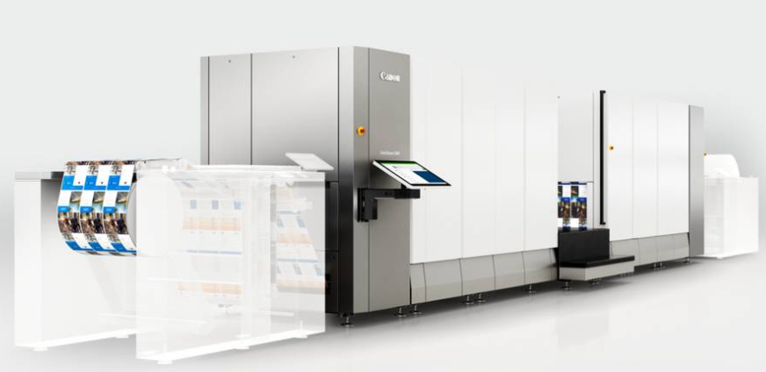
Complex machines and installations
© 2024 canon.nl All rights reserved.
© 2024 laundry.nl All rights reserved.
Examples of high-tech: industrial printer and industrial washing machine.

Slide 5


Complexe machines en installaties
© 2024 safan.nl All rights reserved.
© 2024 kone.nl All rights reserved.
Examples of high-tech: Safan press brake and an escalator.
many parts
software-based control
high availability desired
a breakdown should be resolved as soon as possible.

Slide 6
Traditional approach
Malfunction (standstill)
Supplier sends service engineer
Service engineer arrives and performs root cause analysis
Knowledge intensive
Experience
Manuals
Training
Faster time to market, increased product variation and more complex systems put knowledge transfer under pressure.
Shortage of technicians

Slide 7
Smarter approach (1)
Shortage of technicians, but systems become more complex.
=>> How to support a service engineer?
Use of Bayesian networks to support service engineer in root cause analysis.
Bayesian networks are a discipline within AI that helps to make decisions in situations of uncertainty.
TNO has researched this and built prototypes.

Slide 8
Root cause analysis
Observe
Test (measure, replace)
New evidence
Exit when problem solved?

Slide 9
Smarter approach (2)
Bayesian network, ideal for diagnosis and understanding probabilistic relationships.
=>> no support for decision making (which test?)
Influence diagram, focus on decision making, but also understanding probabilistic relationships.

Slide 10
Research question
What is the feasibility of generating an
Influence Diagram for use in high-tech system diagnostics?
Automatic generation
Modeling tests
Applicability in root cause analysis

Slide 11
Contributions to the key challenges
Contribution
 | Generation | First steps | Type II tests | Pragmatic approach
Automatic generation | xxx | x | x | x
Modeling tests |  |  | xxx | xxx
Root cause analysis |  | xxx |  | xxx
Key challenge
Research method is based on Wieringa’s Design Science Research Methodology

Slide 12
Research question and key challenges
The thesis contains four contributions, which challenge is addressed in which contribution?
What is the feasibility of using an influence diagram for high-tech system diagnostics?
Automatic generation
How to automatically generate influence diagrams for high tech diagnostics? First contribution designs an approach to automatically generate influence diagrams.
Subsequent contributions validate if new modeling ideas can extend this approach.
Modeling tests
What is a good structure for modeling tests in the influence diagram?
Tests can be modeled in various ways, two methods are used.
Third contribution focuses on causal relationships between systems and tests.
Fourth contribution emphasizing the value of tests for diagnosing high-tech systems.
Root cause analysis
Can a generated influence diagram be used for root cause analysis?
Root cause analysis requires a clear next best action but influence diagram can contain multiple decisions, how to choose?
The second contribution uses a myopic algorithm to derive an actionable item,
The fourth contribution investigates how to model the actionable item directly.

Slide 13
So what are influence diagrams?
Concepts, definition and example

Slide 14

AI capability needed for diagnostics is decisioning under uncertainty.
What concepts does an ”AI agent” deciding under uncertainty need?
Subjective beliefs
Beliefs and observations are the only information about the world available to an “agent”.
Trade off instead of a goal
Given uncertainty an agent has to considers possible outcomes, some have much worse consequences than others. It’s not about a goal but a trade off.
Preferences
Decision theory specifies how to trade off the desirability of outcomes with the probabilities of those outcomes. What an agent decides to do depend on its preferences.
How would you compare if an action results in …
a good outcome most of the time, but a disastrous outcome sometimes
a good outcome less often and the disastrous outcome less often and some mediocre outcome most of the time.
From: DAVID L. POOLE & ALAN K. MACKWORTH ARTIFICIAL INTELLIGENCE 3E

Slide 15
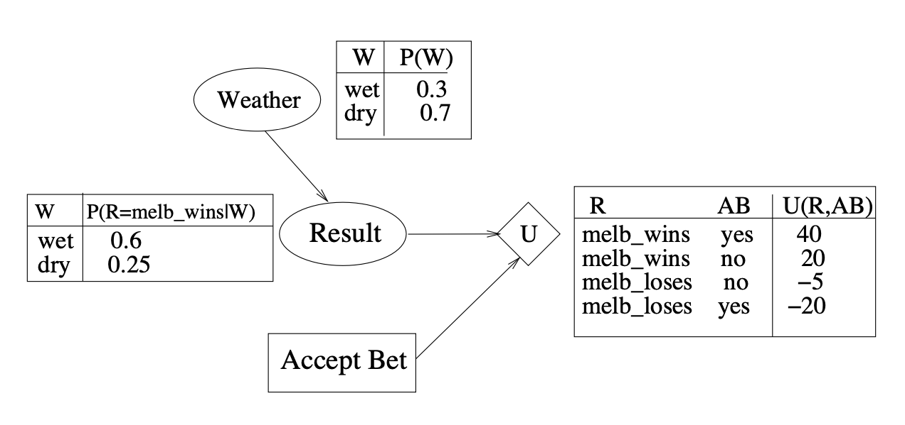
Simple example
Influence diagrams are a probabilistic network for reasoning about decision making under uncertainty.
Clare’s football team, Melbourne, is going to play her friend John’s team, Carlton. John offers Clare a friendly bet: whoever’s team loses will buy the wine next time they go out for dinner. They never spend more than $15 on wine when they eat out. When deciding whether to accept this bet, Clare will have to assess her team’s chances of winning (which will vary according to the weather on the day). She also knows that she will be happy if her team wins and miserable if her team loses, regardless of the bet.
Description
Weather and Result are chance variables. Result causally depends on Weather. Prior probability dry Weather: 0.7.
Accept Bet is a decision node, U is a utility node
Utility values from function U(R, AB) are higher if team wins reflecting preferences.
There is no outcome variable
From: KB Korb, AE Nicholson - Bayesian artificial intelligence

Slide 16
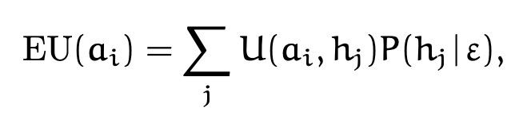
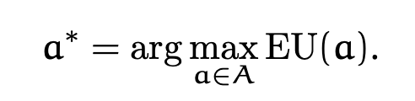
Influence diagrams defined.
Influence diagrams are a probabilistic network for reasoning about decision making under uncertainty.
An influence diagram is a graphical knowledge representation:
of a decision problem involving a sequence of decisions and observations
describing dependence relations between entities of a problem domain
specifying the order on decisions and observations
a quantification of the strengths of the dependence relations
a Bayesian network augmented with decision variables and utility functions specifying the preferences of the decision maker
the utility function U(·) encodes preferences on a numerical scale, associating a utility value to each configuration of its domain variables
Solving a decision problem amounts to:
determining an optimal strategy maximizing expected utility
compute the maximal expected utility of adhering to this strategy.
Given:
Decision variable A with options a₁,...,a_{m},
Hypothesis H with states h₁,...,h_{n},
A set of observations (evidence) ε,
Utility function U(·),
The expected utility of performing action a_{i} is utility of outcome (a_{i} , h_{j} ) * belief in H given ε:
Calculate maximum expected utility by selecting an option a such that a∗ :
From: Uffe Kjaerulff - Bayesian Networks and Influence Diagrams

Slide 17
Key challenge: automatic generation of influence diagrams?
Approach and implementation

Slide 18
Automatically generate influence diagrams Approach to turn captured knowledge into an influence diagram
Automatic Generation of ID’s
Complication:
High-tech systems contain a large # of components and structures are complex.
Creating a influence diagram manually is hard to and error prone.
No software was found to automatically create influence diagrams.
Solution requirements:
High tech systems contains many recurring components, enabling reuse is essential.
Apply steps for manual creation; first causal structure then variable configuration.
Use software solutions for probability networks as much as possible.
Approach:
Converts structured knowledge on systems and tests via 2 steps into an influence diagram.
Uses object orientation to enable reuse and easier validation of parts.
Uses general programming language were needed reuses existing software were possible.
captured knowledge
Object oriented influence diagram
generated influence diagram
support diagnosing system failures
script
script
pyAgrum
Convert knowledge on system and tests into structured descriptions.
Convert captured knowledge into OO influence diagram model using network classes.
Generate influence diagram containing only basic nodes (chance, decision, utility) by expanding objects.
Given evidence infer belief in status of system, advise next steps.

Slide 19
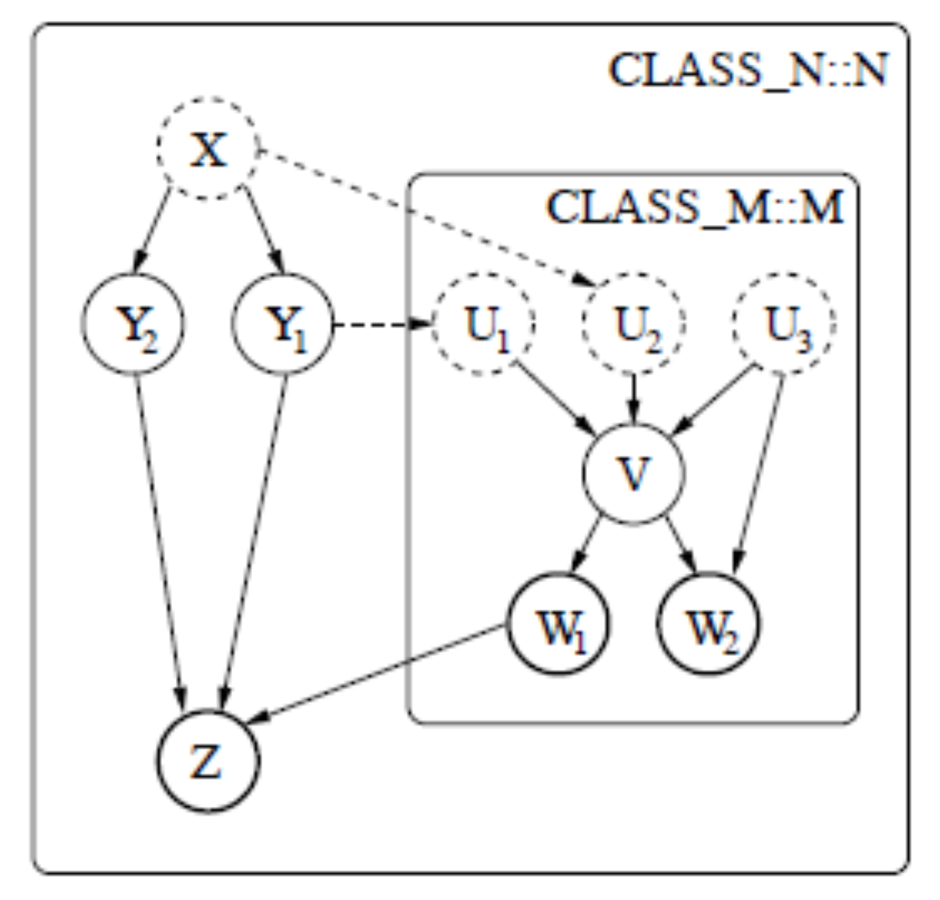
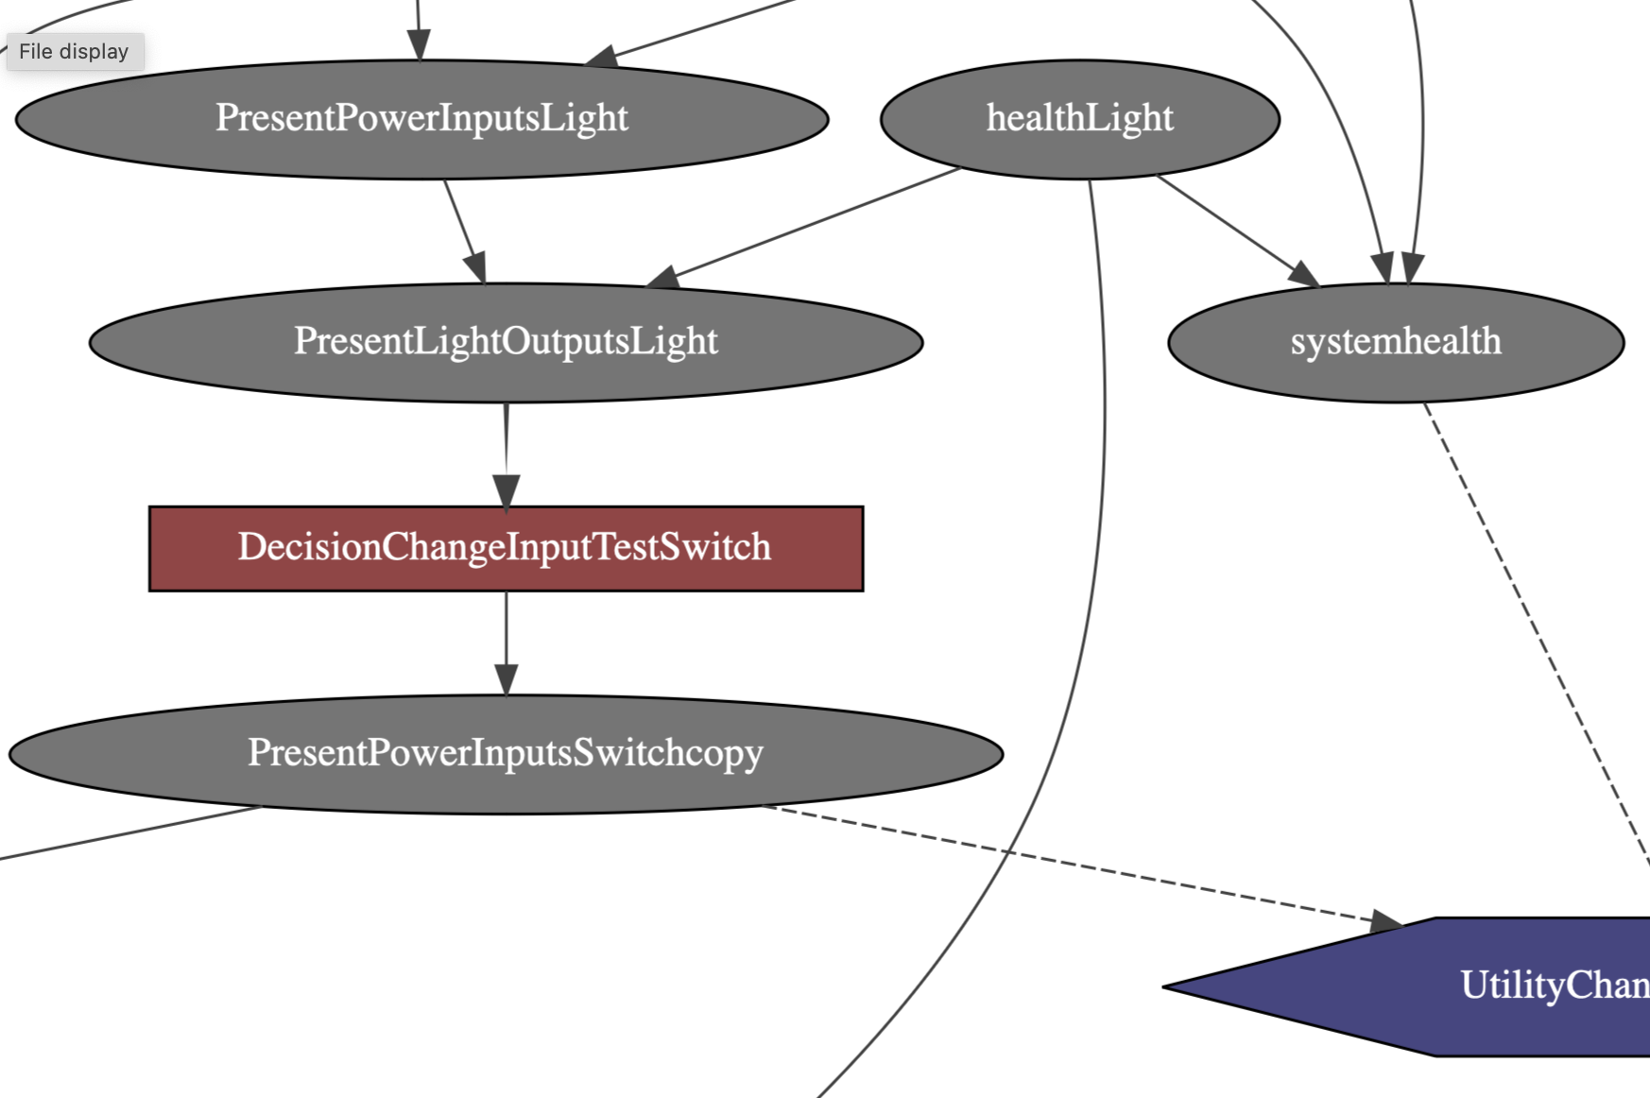
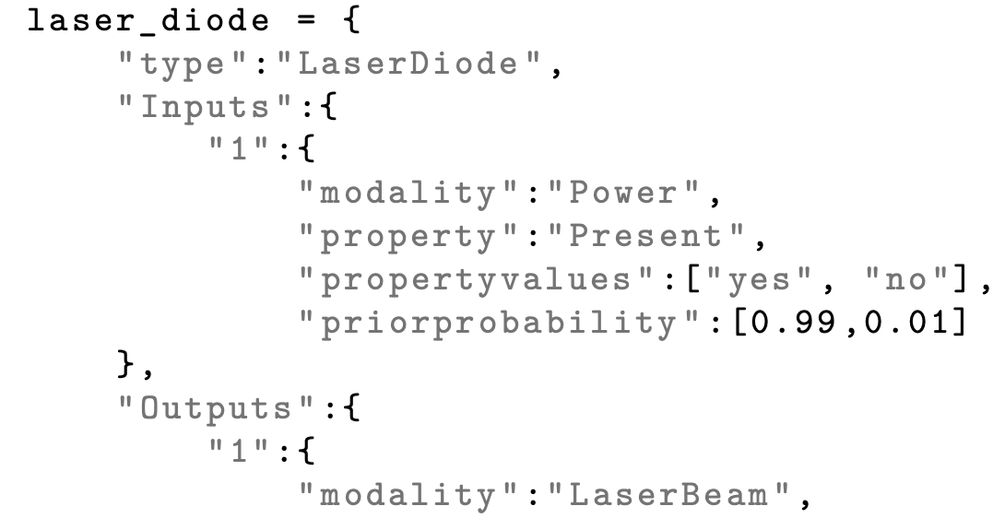
Automatic Generation of ID’s
Object orientation facilitates automatic generation
Deepdive into OO influence diagram step?
Object orientation for influence diagrams uses network classes, small influence diagrams that serve as blueprints for objects.
An ”assembly” defines which objects collectively form an object-oriented influence diagram.
Network classes are natural fit for components, connections, tests or other elements from the problem domain.
Reuse, validation and scaling of diagrams becomes easier.
Network class for component defines inputs, output, health + interfaces
Objects are created from network class and description.
Objects contain all info: structure, states probabilities, connections, ..
Objects are “expanded” to chance, decision, utility nodes as part of an pyAgrum influence diagram.

Slide 20
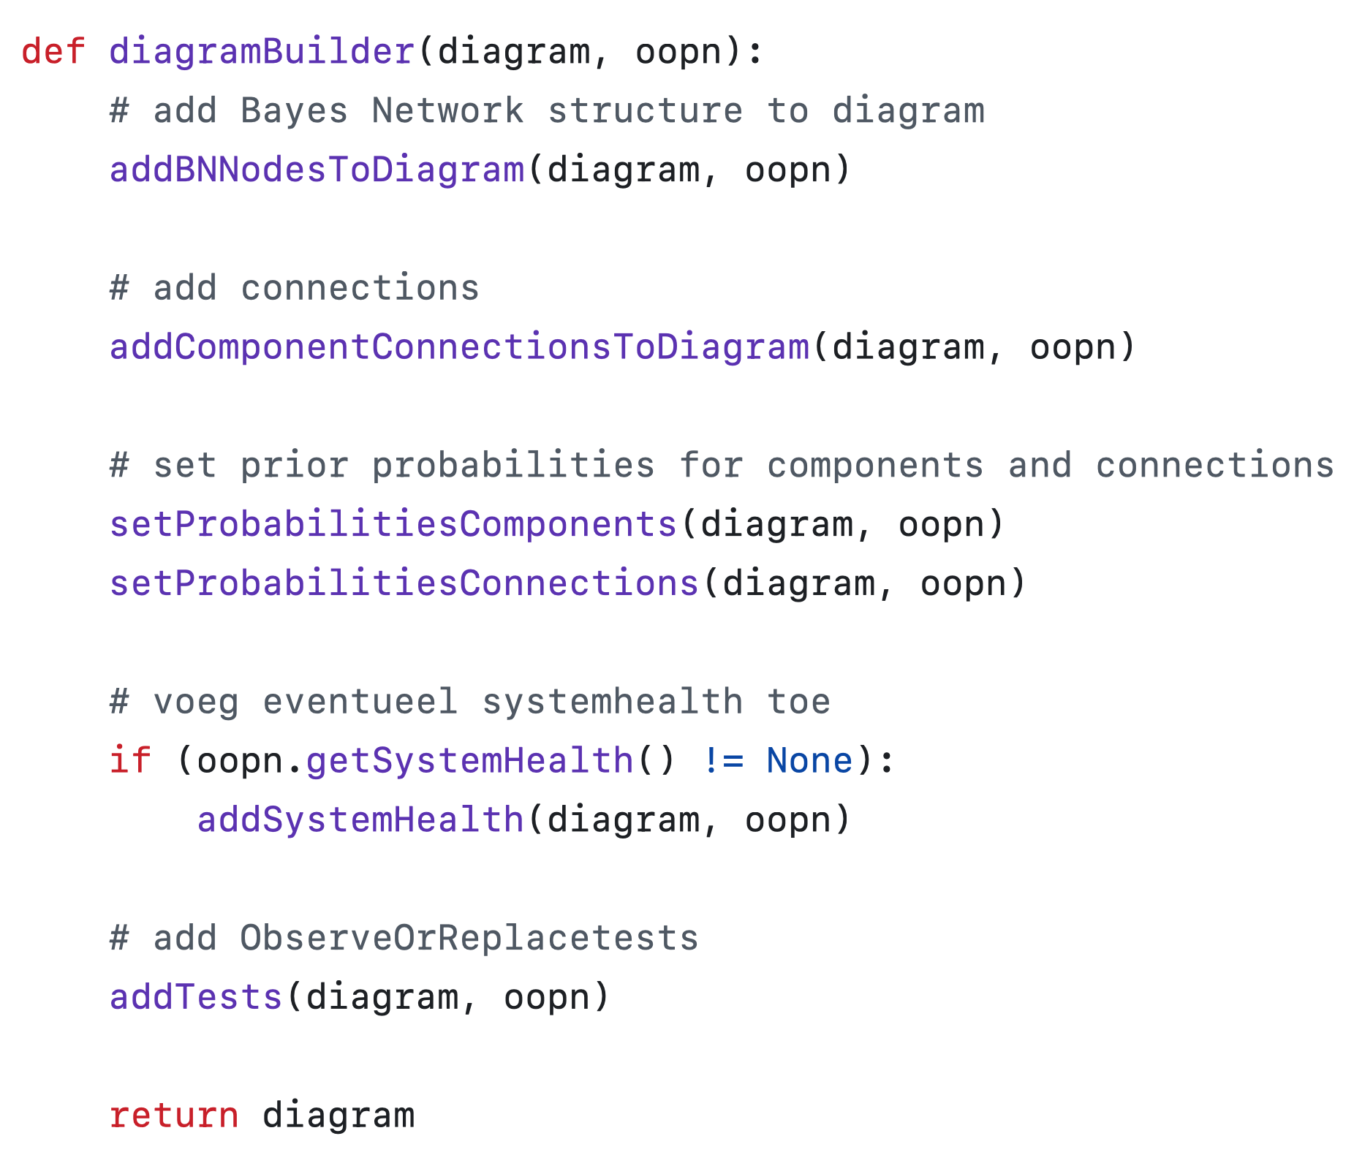
Automatic Generation of ID’s
Extensions and validation
Multiple contributions of our research extended the approach.
Extending approach for tests
Contribution on ”type II test” showed additional tests can be added to the approach via new network classes. Even when test is a system wide test as is the case for this test.
Contribution on “central decision” proved having a seperate network class for tests next to a network class for a component is more flexible.
Validation and conclusion
The approach for the automatic generation of influence diagrams is demonstrated to work, it delivers a valid influence diagram for use in standard library pyAgrum
Dynamic creation of influence diagrams is possible, for example extending diagram based on additional incoming evidence.
While shown effective for small systems and limited tests, it is expected to scale to larger systems.
Script to expand objects into pyAgrum influence diagram

Slide 21
Key challenge: modeling tests?
How to generate, model tests and perform root cause analysis with influence diagrams.

Slide 22
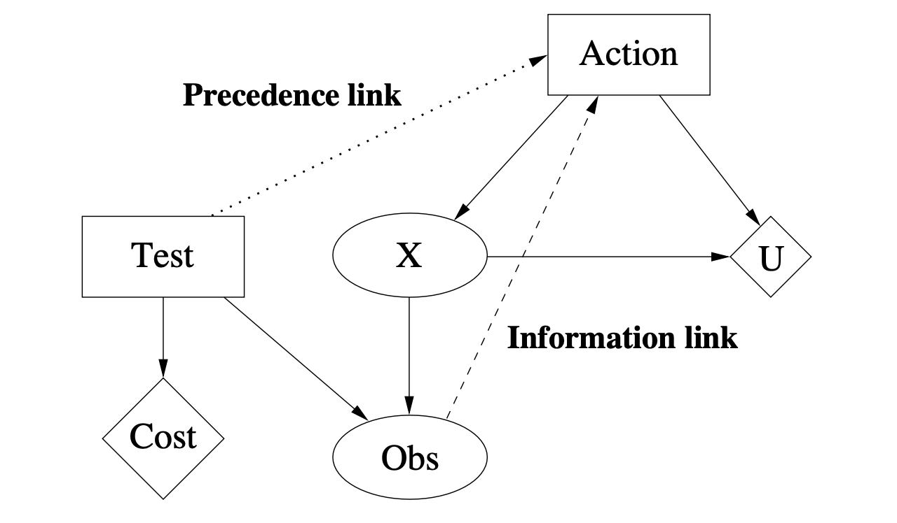
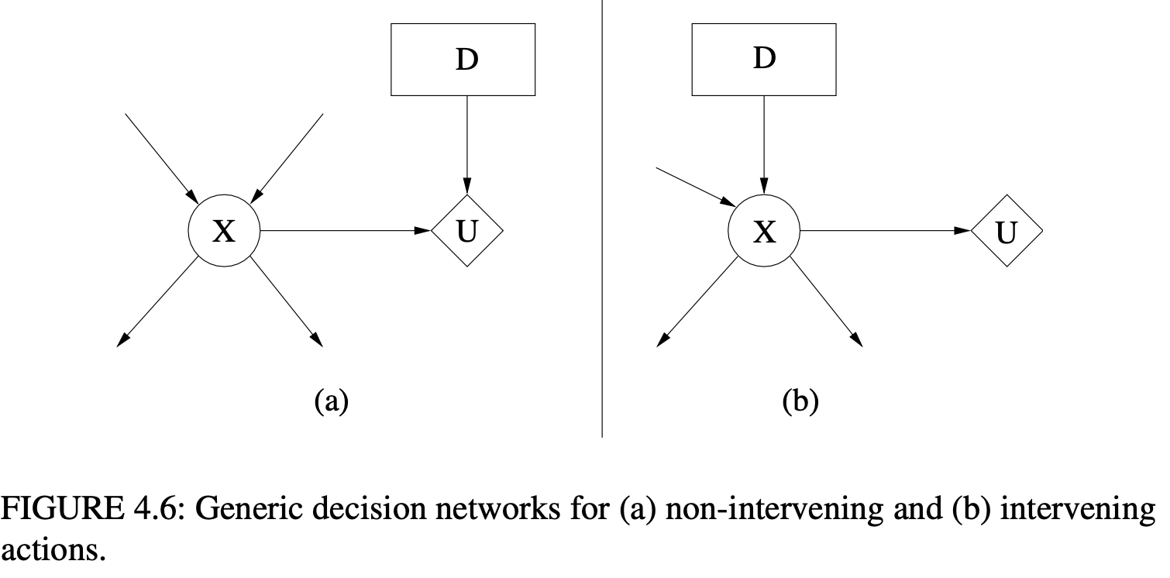
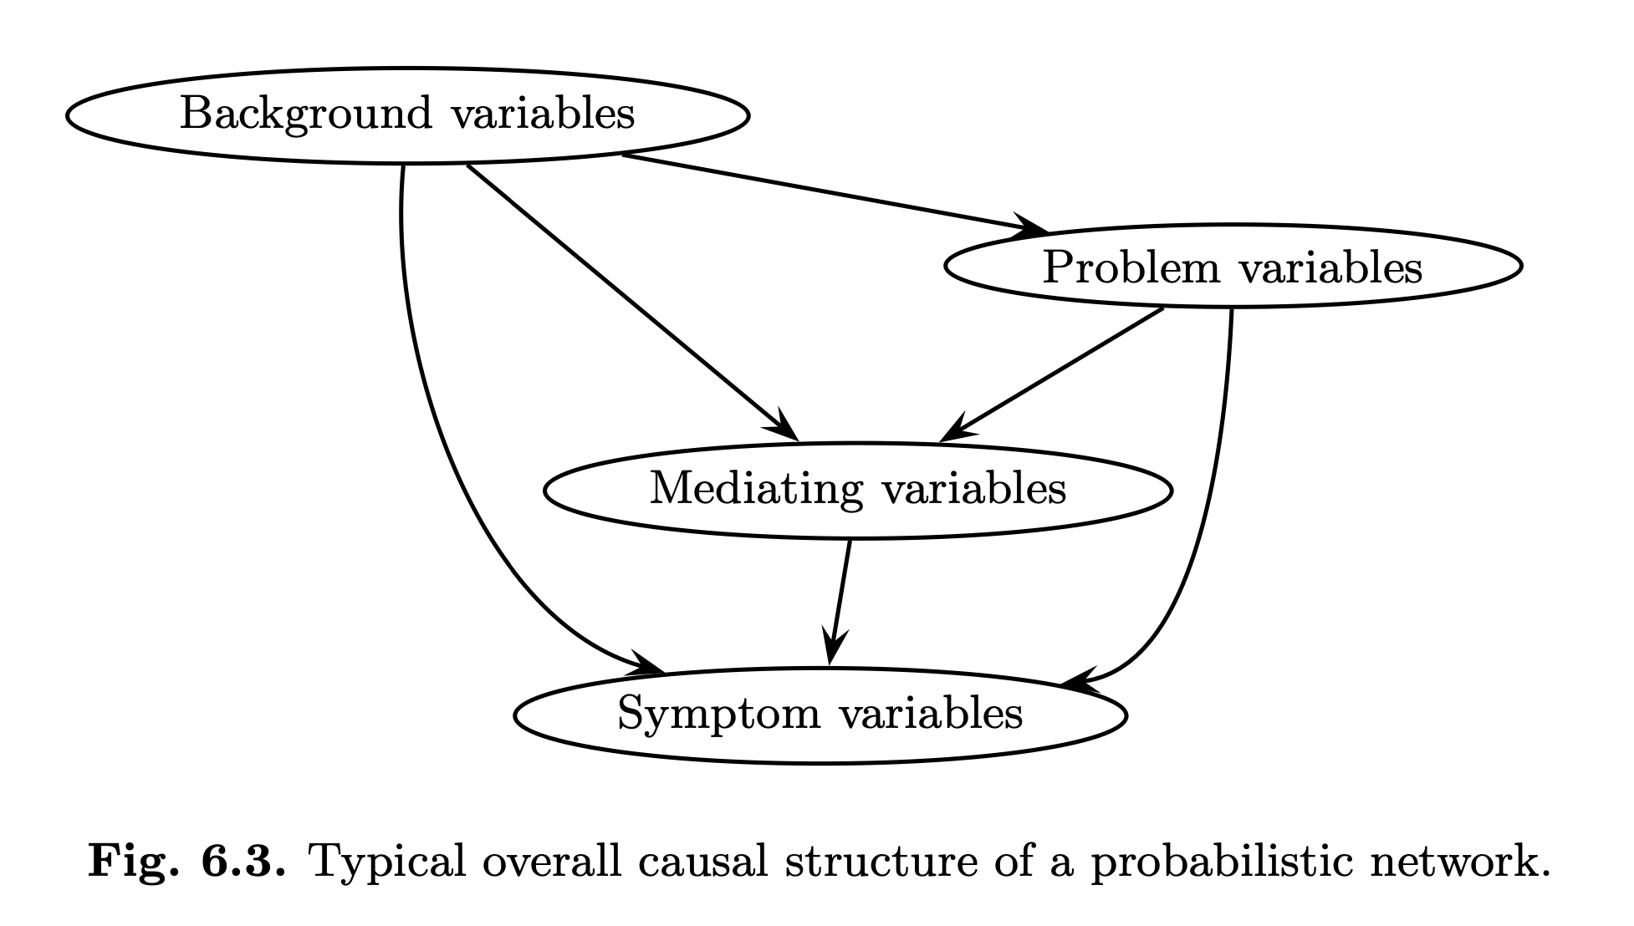
Design patterns used in design test
Bayesian Network or Influence diagram decisioning patterns overview
Causal perspective: problem solving Bayesian Network
Symptom variables information link indicates chance node observed before decision.
Problem variables
Sdfdsfklj
Background variables
Dfsafdfsa
Mediating variables
dfsf
df
Decision design patterns I
Conditional decision information link indicates chance node observed before decision.
Sequential decision or a plan
Test/observe decision before action carrying a cost.
Precedence link indicates ordering of decisions. Uses no-forgetting assumption.
Decision design patterns II
Two types of actions in decision problems:
Figure a: non intervening: no direct effect on chance variables. About optimizing a utility drive decision.
Figure b: (causal) intervening: direct effect on ‘the world’ due to causal modelling. This is about explaining and predicting a causal process under external perturbation. Mostly focussed on a single chance node.

Slide 23
Modeling type II test
Testgoal:
Change input to get additional system output observation
Decision
Input C1
System Health
Input C1
Additional
Input C1
System Health
Health C1
Input C1c
Health C1
Step 1
Using system model from literature C1 / C2 / C3 are components with one or more inputs, 1 output an a health variable
Output C3 is a observable ‘symptom’ variable, health C# are unobervable ‘problem variables.
System health variable aggregates all health variables and so mediates with other parts of the diagram.
Utility
Output C1
Output C1
Input C2
Input C2
Health C2
Health C2
Output C1c
C1: component 1
Output C2
Output C2
Health C3
Input C2c
Health C3
C2: component 2
C3: component 3
Input C3
Input C3
Additional
Input C3
C1c: component 1 copy
Output C2c
C2c: component 2 copy
Output C3
C3c: component 3 copy
Output C3
Input C3c
Output C3c

Slide 24
Modeling type II test
Step 2
System need to be duplicated to accomodate better dermination of health of components.
Only variables that are directly affected by the input change are duplicated.
New variables keep health and other inputs of component as parents.
Decision
Input C1
Additional
Input C1
System Health
Input C1c
Health C1
Input C1c
Utility
Output C1
Input C2
Health C2
Output C1c
Output C1c
C1: component 1
Output C2
Input C2c
Health C3
Input C2c
C2: component 2
C3: component 3
Input C3
Additional
Input C3
C1c: component 1 copy
Output C2c
Output C2c
C2c: component 2 copy
Output C3
C3c: component 3 copy
Input C3c
Input C3c
Output C3c
Output C3c

Slide 25
Modeling type II test
Decision
Step 3
The utility of the type II test has as parents:
System health: behavior is normal or faulty
Input C1: to know old input
Input C1c: to determine new input.
Decision based on embedded preferences sets new input upon faulty system behavior and so is parent of Input C1c.
Output C3 is conditional as otherwise it is not known if system behavior is faulty.
Decision
Input C1
System Health
Input C1
Additional
Input C1
System Health
Input C1c
Health C1
Input C1c
Utility
Utility
Output C1
Input C2
Health C2
Output C1c
C1: component 1
Output C2
Health C3
Input C2c
C2: component 2
C3: component 3
Input C3
Additional
Input C3
C1c: component 1 copy
Output C2c
C2c: component 2 copy
Output C3
C3c: component 3 copy
Output C3
Input C3c
Output C3c

Slide 26
Modeling type II test
Final diagram
When one or more component healths are believed to be broken System Health indicates faulty system state.
Preferences in utility determine decision to switch input, input C1c is set to other state then input C1
Given duplicated system all component health is now determined based on initial and additional system behavior.
Next steps like tests or repair actions can follow from components health variables.
Decision
Input C1
Additional
Input C1
System Health
Health C1
Input C1c
Utility
Output C1
Input C2
Health C2
Output C1c
C1: component 1
Output C2
Health C3
Input C2c
C2: component 2
C3: component 3
Input C3
Additional
Input C3
C1c: component 1 copy
Output C2c
C2c: component 2 copy
Output C3
C3c: component 3 copy
Input C3c
Output C3c

Slide 27
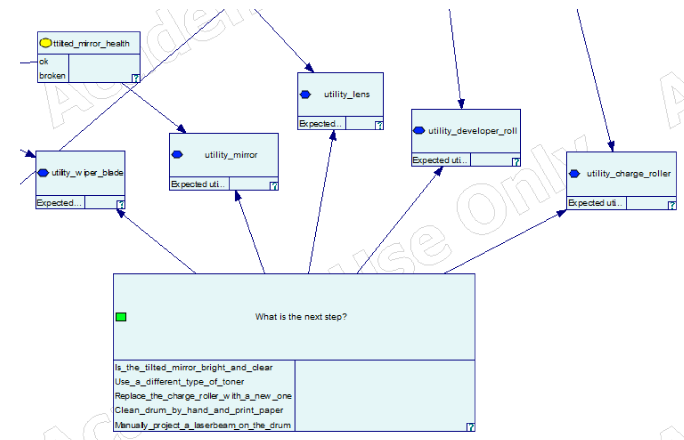
Start from next step instead of system
Model value of test for component determines next best step.
Health of component input to determine value of test.
Value of test for its component
Which test todo is part of this decision variable

Slide 28
Modeling type II test
Test modelling overview
Design patterns, modeling and validation results
Design patterns
Design patterns help model tests, other test can be modeled using same approach.
Causal perspective reference design…
(non)intervening decisions…
Designing tests
First analyse causal structure of test and information needed for test. Next map to design patterns.
Alternative designs are possible but main structure
Validation of design
Validation showed causal mechanisms are found to be present.
Behavior easily changes with parameters.
Path forward
Should modeling be continued via test causal relation analysis + mapping to design patterns or is modeling decisions from perspective of stakeholders better.
Combining both approaches should be possible

Slide 29
Key challenge: root cause analysis
…

Slide 30
root cause analysis using myopic algorithm.
Root cause analysis
In section \ref{chapter.myopic.search}, the approach to automatically generate influence diagrams is applied to create a diagram for a small system. The structure of this Influence Diagram (ID) is based on the research by \cite{HTdiagnosis}. This contribution explores how the generated \acrshort{id} can be utilized for root cause analysis using a myopic search approach, making it exploratory in nature.
The steps include deriving the appropriate influence diagram structure, capturing the details of a specific system (a printer), and implementing the myopic algorithm. As demonstrated in section \ref{section.validation.design.myopic}, possible tests are organized in a convenient order, with the myopic algorithm suggesting the next best test. This indicates the feasibility of generating an ID for root cause analysis.
However, there are drawbacks. The inference engine must perform a separate run for each test and compare the results. As the model grows, this could present significant challenges in terms of computing power. Another limitation is that each test is restricted to a single component. In practice, some tests provide insights into multiple components simultaneously, especially for type II and type IV tests.
The contribution demonstrates that root cause analysis with an automatically generated influence diagram is possible. The solution requires additional programming to determine the best test. A more efficient approach would fully utilize the \acrshort{id}'s capabilities to determine the test order, eliminating the need for separate inference runs for each test and improving performance. This approach is detailed in the final contribution (see section \ref{section.exclusiveID.introduction}), where an ID is generated to determine the optimal test sequence without additional logic.

Slide 31
modeling tests as influence diagrams using simplified decision making.
Simplied decision making
The final contribution in Chapter \ref{chapter.dedicatedID} utilizes the \acrfull{id} without additional programming to create a practical model. This model features a single decision node that queries, "What is the next test action?". All potential tests, whether observational or replacement, are modeled in response to this decision, and may apply to one or more components. Each component is associated with a utility table that governs the relevant tests and their expected utility.
The model's validation involved varying test costs, adjusting prior probabilities, and simulating a simple root cause analysis scenario. Based on these validations, the approach presents the sequence of tests logically.
This contribution focused on establishing an effective structure. Validation affirmed that the chosen \acrshort{id} structure is suitable for root cause analysis. Future research could explore the solution's scalability and investigate methods for planning multiple steps ahead.

Slide 32
Future research
Conclusion + future research
This research presents an approach to automatically generate Influence Diagrams (IDs) based on structured knowledge and demonstrates the modeling of tests via influence diagrams. It also shows methods to perform optimal root cause analyses with the help of an \acrshort{id}, either through an algorithm or by modeling a central decision.
Future work should include simulating the automatic generation approach for much larger systems. While the approach is expected to remain effective, other challenges like diagram validation and performance issues might arise.
Previous research in high-tech system diagnostics used Bayesian Networks to model internal causal mechanisms of systems and tests. This study builds on this approach by modeling a type II test in the same way. Modeling other test types should be possible by reusing the presented design patterns and insights from designing the type II test.
Contribution four (see Chapter \ref{chapter.dedicatedID}) explored another modeling path, starting with a central decision to determine the next best action. This approach only models test elements relevant for the next best action. Combining the approaches of contributions 2 and 4 could be beneficial, integrating causal mechanisms with clear decision-making to aid service engineers.
As mentioned in Paragraph \ref{section.diagnostic-tests}, numerous combinations need to be considered before identifying the root cause of a malfunction. Further research could investigate the potential of using an \acrshort{id} to anticipate beyond the next round of testing, deriving the most efficient path.

Slide 34
Iteration 1: generating influence diagram from captured knowledge
Given prior research on high tech system diagnotics can we generate an influence diagram to support diagnostics?

Slide 35
Meer over knowledge capturing?
Intuitie: stakeholders
Behouden: systeem modellering
Verplaatsen ID modellering items
Genereren: 4 stappen benoemen
Bijlage prototype(n)
Generating influence diagram from captured knowledge Contents of iteration 1 in overleaf + todo
Research questions
Improvement investigations
Design and develop
Validation
Evaluation
Intro and approach
Goal
explore generation of ID’s
Scope
Small system
Stakeholder Improvements
Intuition
Research questions
System description?
Model system, tests, repairs?
Steps to generate?
How to validate resulting diagram?
Approach
Wieringa’s engineering cycle
Contents of iteration
Topics in iteration
Approach
Conceptual model problem context
Key stakeholder improvements
Per stakeholder
Prior knowledge
TNO-ESI: MBD, System, BN
Beurskens: ID for HT systems
Kjearulff: OO ID construction
Validate ID
Unit testing
Software
todo
Approach
Treatment requirements
Design decisions: modelling / generation
Requirements modelling
System structure + behavior
Observe / replace test
Evaluating requirements
ID generation
Discovery via prototype
OOPN
Information model in software
requirements
Evaluating requirements
Validation
…
Insights,
Learning
Next steps
Research Questions:
In what format should system description and diagnosis actions be supplied to
accommodate generation of influence diagrams?
How should a system, tests and repair actions be modelled in an influence diagram?
What are the steps to generate an influence diagram? How to implement these steps?
How can the resulting diagram be validated?

Slide 36
Beschrijving
Vanuit ontwerpfase vangen van de voor onderhoud benodigde kennis van een systeem.
doel
Kennis systeem en testen vastleggen op manier die aansluit op ontwerp van het systeem.
Vastlegging kan worden ingelezen in software om informatiemodel op te bouwen of direct een influence diagam te genereren.
systeem beschrijven
Een systeem kent een structuur en gedrag dat als normaal of failure kan worden betiteld. Een systeem bestaat uit componenten en connecties daartussen. Een component heeft 1 of meerdere inputs, 1 output en een health onderdeel om de vooraf bekende kans op problemen te modelleren. Een connectie verbind componenten en heeft ook een health omdat ook een verbinding kan falen.
test beschrijven
Van een test dient bekend te zijn waar in het systeem er 1 of meer aanhaakpunten zijn. Vervolgens moet bekend zijn uit welke onderdelen een test nog meer bestaat, bijvoorbeeld de reparatie acties als gevolg van de test. Test uitvoeren wordt geadviseerd op basis van vastgelegde voorkeuren, in huidige model is dat minimalisatie van kosten zodat ook kostenstructuren bekend moeten zijn.
vorm van beschrijving
Werken met subnetwerken of typen helpt om beschrijvingen beknopt te houden. Een type, zoals een specifiek test, kan vooraf onderkend worden en toegevoegd aan de bibliotheek waarmee de beschrijving kan worden opgesteld.
Meerdere vormvarianten van beschrijvingen zijn mogelijk (objectstructuren, dataformats) als er maar een informatiemodel of direct een influence diagram uit kan worden gegenereerd.

Slide 37
OO influence diagram model
Centraal model voor een probability netwerk vertaald kennis naar influence diagram.
doel
Het informatiemodel bestaat om het genereren van een influence diagram te ondersteunen. Het informatiemodel wordt opgebouwd vanuit beschrijvingen van het systeem en testen/acties. Het informatiemodel kan ook domeinregels implementeren en bewaken dat er aan wordt voldaan.
onderdelen
Het informatiemodel modelleert het systeem, testen/acties en hoe deze samenwerken. Verschillende onderdelen zijn te modelleren als mini influence diagrammen. Templates voor deze diagramen worden vastgelegd in “netwerk klassen” volgens de object oriented probability network aanpak.
netwerk klassen
Een network class is een mini influence diagram met nodes, verbindingen, besluiten en utilities. Een network class heeft interfaces naar andere network classes. Instanties van netwerk klassen werken met elkaar samen binnen het informatiemodel en kunnen worden omgezet naar onderdelen van een influence diagram. Een netwerk klasse implementeert ook domein regels, bijvoorbeeld dat een component meerdere inputs kan hebben maar 1 output en 1 health.
opbouwen informatie model
Het informatie model wordt opgebouwd via de volgende stappen.
Een element uit de beschrijving, bijvoorbeeld component: light wordt gematched op network class “component”.
Een instantie van de netwerk class wordt opgenomen in het informatiemodel en verbonden met relevante andere instanties, bijvoorbeeld via een connectie: wire.
Naast structuur bevat de instantie van de network class alle informatie nodig om node(s) in een influence diagram te maken, zoals de conditional probability tabel van een output node gemaakt op basis van een normaal/ failure gedrag tabel uit de beschrijving.

Slide 38
Informatiemodel
Klassendiagram voor systeem met 1 test type
legenda:
Network classes
Interfaces schuin gedrukt
Informatiemodel
Naam
Componenten:Component
Connecties:Connectie
Test:
- Testtype:Test Network class
- Target: Component(s)
Het informatiemodel bevat de systeemonderdelen en een testmapping. Het systeem bestaat uit componenten en connecties. Elke testvariant is een eigen netwerk klasse gekoppeld aan component(en).
Netwerk klassen zijn hiernaast gearceerd, dit zijn templates voor “mini” influence diagrammen met interfaces naar instanties van andere netwerkklassen.
De netwerk klassen implementeren de regels die bepalen hoe een systeem-onderdeel of test functioneert. Voorbeelden van regels zijn onder de klassen opgenomen
Uitbreiden met nieuwe testen betekent een nieuwe netwerk klassen toevoegen, bepalen wat de interfaces zijn en welke parameters voor de test relevant zijn. Deze input dient in de beschrijving te zijn opgenomen.
1
1
n
n
n
Connectie
Component
Observe/replace test
Type
Startcomponent
Eindecomponent
Health (+ prior)
Normaal/failure gedrag
Naam
Type
Input(s):Node
Output:Node
Health:Node
Interne verbindingen
Naam
TestDecision: Node
TestUtility:Node
TestOutcome:Node
ReplaceDesicion:Node
ReplaceUtility:Node
Interne verbindingen
1
1
1
1
1
1
Regels:
Verbind output component 1 met
input component 2.
Regels:
Component heeft meerdere inputs maar 1 output.
Alle nodes hebben arc met output.
Naamgeving structuur voor nodes.
Gedrag tabel bepaald prior output.
n
n
Regels:
Kosten bepalen utility replace.
Testkosten bepalen utility test.
Gedrag tabel bepaald prior testoutcome
Node
Naam
Type
Variable:LabelizedVariable
Prior:Potential
Regels:
Prior tabel voor alle inkomende arcs.

Slide 39
Oude dias

Slide 40
Concept kennis over een high tech systeem toepasbaar maken voor reparateurs tijdens diagnosticeren
systeem + testen en acties
Influence diagram oplossing
diagnoticeren en repareren high tech systemen
beschrijving
informatie model
influence diagram
support diagnosticeren
Kennis systeem en testen vertalen naar beschrijving(en)
Beschrijving(en) inlezen en vertalen naar informatiemodel
Informatie model basis voor genereren influence diagram
Gegeven evidence afleiden “geloof” in status systeem en adviseren next steps
Uitvoeren geadviseerde stappen, invoer evidence (observaties en testuitkomst).

Slide 41
Onderdelen oplossing
van beschrijving naar gegenereerd influence diagram via een informatiemodel
beschrijving
Startpunt zijn beschrijvingen van het systeem en van testen / acties opgesteld door kennishouders. Van een systeem worden structuur en gedrag (normaal / failure) vastgelegd. Van testen/acties dient minimaal structuur, gedrag en positionering tov het systeem te worden vastgelegd.
informatie model
Een informatie model met daarin Object Oriented Probability Network (OOPN) klassen wordt ingericht vanuit de beschrijvingen. Het informatiemodel implementeert regels waaraan systeemonderdelen en testen dienen te voldoen.
Er is geen software dat OOPN klassen ondersteund zodat dit in python is geïmplementeerd. Voordeel van een separaat informatiemodel is dat het onafhankelijk is van de gebruikte influence diagram tooling. Ook is het flexibeler om dynamisch influence diagrammen samen te stellen.
influence diagram
Uit het informatiemodel met OOPN klassen kan een specifiek influence diagram worden gegenereerd. Zo’n diagram wordt vervolgens gebruikt binnen bestaande software voor influence diagrammen om het stellen van diagnoses te supporten.
support diagnosticeren
Gegeven observaties en/of resultaten van uitgevoerde testen/acties bouwt het influence diagram een beeld op van hoe een systeem er voor staat en op basis van ingebakken voorkeuren bepaald het wat de beste vervolgactie is.

Slide 42
Beschrijving
Vanuit ontwerpfase vangen van de voor onderhoud benodigde kennis van een systeem.
doel
Kennis systeem en testen vastleggen op manier die aansluit op ontwerp van het systeem.
Vastlegging kan worden ingelezen in software om informatiemodel op te bouwen of direct een influence diagam te genereren.
systeem beschrijven
Een systeem kent een structuur en gedrag dat als normaal of failure kan worden betiteld. Een systeem bestaat uit componenten en connecties daartussen. Een component heeft 1 of meerdere inputs, 1 output en een health onderdeel om de vooraf bekende kans op problemen te modelleren. Een connectie verbind componenten en heeft ook een health omdat ook een verbinding kan falen.
test beschrijven
Van een test dient bekend te zijn waar in het systeem er 1 of meer aanhaakpunten zijn. Vervolgens moet bekend zijn uit welke onderdelen een test nog meer bestaat, bijvoorbeeld de reparatie acties als gevolg van de test. Test uitvoeren wordt geadviseerd op basis van vastgelegde voorkeuren, in huidige model is dat minimalisatie van kosten zodat ook kostenstructuren bekend moeten zijn.
vorm van beschrijving
Werken met subnetwerken of typen helpt om beschrijvingen beknopt te houden. Een type, zoals een specifiek test, kan vooraf onderkend worden en toegevoegd aan de bibliotheek waarmee de beschrijving kan worden opgesteld.
Meerdere vormvarianten van beschrijvingen zijn mogelijk (objectstructuren, dataformats) als er maar een informatiemodel of direct een influence diagram uit kan worden gegenereerd.

Slide 43
Informatie model
Centraal model voor een probability netwerk vertaald kennis naar influence diagram.
doel
Het informatiemodel bestaat om het genereren van een influence diagram te ondersteunen. Het informatiemodel wordt opgebouwd vanuit beschrijvingen van het systeem en testen/acties. Het informatiemodel kan ook domeinregels implementeren en bewaken dat er aan wordt voldaan.
onderdelen
Het informatiemodel modelleert het systeem, testen/acties en hoe deze samenwerken. Verschillende onderdelen zijn te modelleren als mini influence diagrammen. Templates voor deze diagramen worden vastgelegd in “netwerk klassen” volgens de object oriented probability network aanpak.
netwerk klassen
Een network class is een mini influence diagram met nodes, verbindingen, besluiten en utilities. Een network class heeft interfaces naar andere network classes. Instanties van netwerk klassen werken met elkaar samen binnen het informatiemodel en kunnen worden omgezet naar onderdelen van een influence diagram. Een netwerk klasse implementeert ook domein regels, bijvoorbeeld dat een component meerdere inputs kan hebben maar 1 output en 1 health.
opbouwen informatie model
Het informatie model wordt opgebouwd via de volgende stappen.
Een element uit de beschrijving, bijvoorbeeld component: light wordt gematched op network class “component”.
Een instantie van de netwerk class wordt opgenomen in het informatiemodel en verbonden met relevante andere instanties, bijvoorbeeld via een connectie: wire.
Naast structuur bevat de instantie van de network class alle informatie nodig om node(s) in een influence diagram te maken, zoals de conditional probability tabel van een output node gemaakt op basis van een normaal/ failure gedrag tabel uit de beschrijving.

Slide 44
Informatiemodel
Klassendiagram voor systeem met 1 test type
legenda:
Network classes
Interfaces schuin gedrukt
Informatiemodel
Naam
Componenten:Component
Connecties:Connectie
Test:
- Testtype:Test Network class
- Target: Component(s)
Het informatiemodel bevat de systeemonderdelen en een testmapping. Het systeem bestaat uit componenten en connecties. Elke testvariant is een eigen netwerk klasse gekoppeld aan component(en).
Netwerk klassen zijn hiernaast gearceerd, dit zijn templates voor “mini” influence diagrammen met interfaces naar instanties van andere netwerkklassen.
De netwerk klassen implementeren de regels die bepalen hoe een systeem-onderdeel of test functioneert. Voorbeelden van regels zijn onder de klassen opgenomen
Uitbreiden met nieuwe testen betekent een nieuwe netwerk klassen toevoegen, bepalen wat de interfaces zijn en welke parameters voor de test relevant zijn. Deze input dient in de beschrijving te zijn opgenomen.
1
1
n
n
n
Connectie
Component
Observe/replace test
Type
Startcomponent
Eindecomponent
Health (+ prior)
Normaal/failure gedrag
Naam
Type
Input(s):Node
Output:Node
Health:Node
Interne verbindingen
Naam
TestDecision: Node
TestUtility:Node
TestOutcome:Node
ReplaceDesicion:Node
ReplaceUtility:Node
Interne verbindingen
1
1
1
1
1
1
Regels:
Verbind output component 1 met
input component 2.
Regels:
Component heeft meerdere inputs maar 1 output.
Alle nodes hebben arc met output.
Naamgeving structuur voor nodes.
Gedrag tabel bepaald prior output.
n
n
Regels:
Kosten bepalen utility replace.
Testkosten bepalen utility test.
Gedrag tabel bepaald prior testoutcome
Node
Naam
Type
Variable:LabelizedVariable
Prior:Potential
Regels:
Prior tabel voor alle inkomende arcs.

Slide 45
Informatie model: testmodellering
testbesluit triggeren op kans * voorkeuren
doel
Een test in onze context is een actie om te bepalen waar er zich in het systeem problemen bevinden. Een test kan gekoppeld zijn aan actie(s) om systeemonderdelen te vervangen of herstellen. Als een test en actie bij elkaar horen zijn ze in 1 netwerk klasse samengebracht in het informatiemodel.
onderdelen test
Een test is verbonden op 1 of meerdere punten (health/output) met het systeem, de status van onderdelen in het systeem (output / health) triggert 1 of meer utilities in de test.
Een test bevat 1 of meer besluiten om een test of reparatieactie uit te voeren welke worden gestuurd door voorkeuren opgeslagen in utilities. Deze besluiten zijn gerelateerd aan elkaar. Bijvoorbeeld de observe/vervang test voert een observatie pas uit als niet zeker is dat een component vervangen moet worden.
De exacte handeling van de test wordt niet gemodelleerd, na uitvoeren van de test is er evidence mbt de testuitkomst. Uiteraard moet ergens anders bekend zijn hoe de test moet worden uitgevoerd.
De testuitkomst heeft impact op systeemonderdelen en eventuele vervolgbesluiten.
typen testen
Initieel is maar 1 type test gemodelleerd, vervolgiteraties voegen testen toe:
Type 1: indien output niet conform verwachting checken hoe andere delen van de systeem keten ervoor staan.
Type 2: indien output niet conform verwachting via ander input scenario checken welke output wordt geproduceerd.
Type 3: als output niet conform verwachting (tijdelijk) vervangen component.
Type4: als output niet conform verwachting systeem aanpassen, bijvoorbeeld delen systeem in afzondering testen.

Slide 46
influence diagram
Op basis van informatiemodel genereren van een influence diagram
doel
Omzetten van het informatiemodel naar een influence diagram welke binnen bestaande geschikte software te gebruiken is. In huidige implementatie is van pyAgrum klasse InfluenceDiagram.
stappen
Omdat het informatiemodel alle informatie bevat om een influence diagram te maken is genereren een kwestie van 1 op 1 omzetten van informatiemodel elementen naar diagram elementen:
Per instantie van een component nodes aanmaken in influence diagram
Aanmaken interne connecties van component
Aanmaken connecties tussen componenten
Toevoegen prior probability tabellen componenten en connecties
Toevoegen instanties van testen (@ onderdelen van)

Slide 47
support diagnoticeren
kennis via influence diagram toepasbaar maken voor diagnose en reparatie
doel
Als laatste onderdeel kan via interactie met reparatie deskundigen hulp worden geboden tijdens het diagnoticeren van systemen met problemen.
stappen
Voeden influence diagram met observaties en/of resultaat uitgevoerde acties.
Via inference opbouwen geloof in status systeem en dmv gemodelleerde voorkeuren adviseren next steps.
Next steps uitvoeren
itereren van stappen 1 / 2 / 3 totdat systeem naar behoren werk.
uitlezen next steps
Bepalen advies uit te voeren next step vereist een algoritme na inference. Zie volgende slide voor 2 alternatieven.
terug naar informatie model
Bepaalde evidence kan duiden op een situatie waarvoor aanpassing van het influence diagram nodig is. Dit kan resulteren in een stap terug naar het informatiemodel en opnieuw generen van een aangepast influence diagram. Voorbeeld is als in de evidence twee states van 1 component zijn opgenomen zoals bij een type 2 test (”print” en “copy”) met bijbehorend resultaat (”print” en “no print”). Deze extra informatie vereist aanpassing van het influence diagram zodat bij volgende inference met beide situaties rekening kan worden gehouden. Zie ook verderop in deze ppt.
Evidence:
Input: “copy” / “no print”
influence diagram
support diagnosticeren
Evidence:
Input: “copy” / “no print”
Input: “print” / “print”
aangepast informatie model
influence diagram
support diagnosticeren

Slide 48
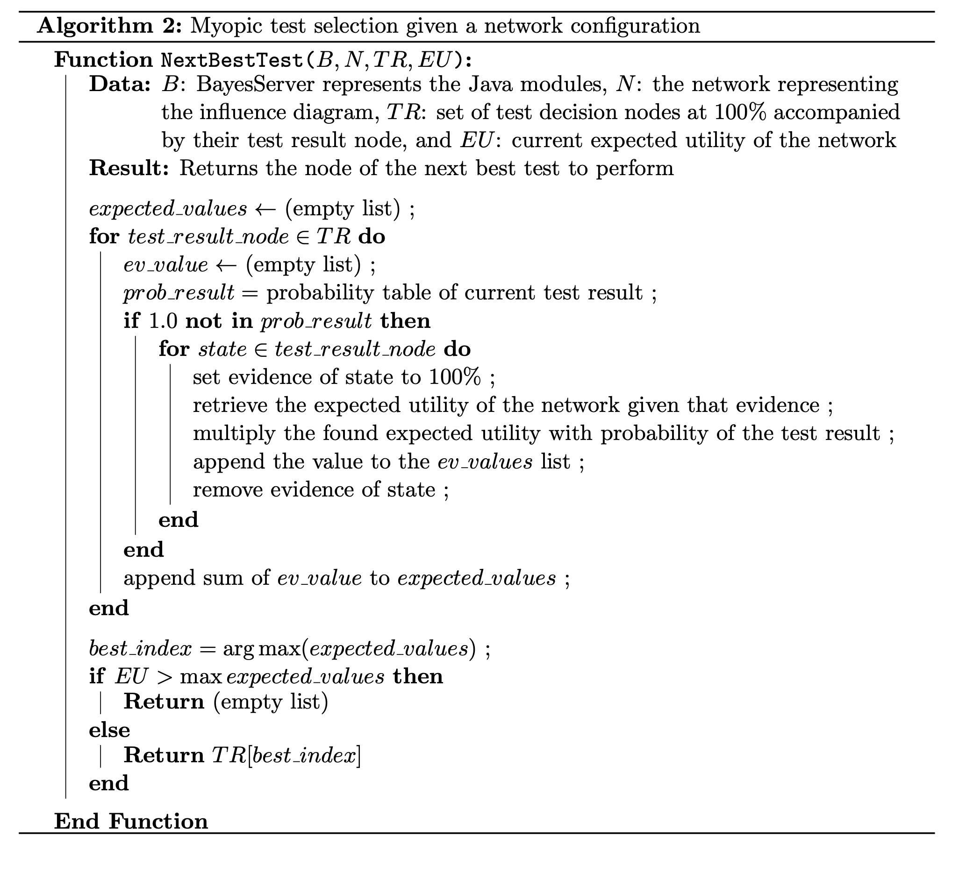
Support diagnosticeren: afleiden next step
2 algoritmes om de next step af te leiden
Algoritme 1, Joep Beurskens
Doorloop Test besluiten op 100% (=yes)
zet elke state van testresultaat een keer op 100% en bereken network expected utility
weeg resultaat met kans op deze state bij het testresultaat
Bepaal welke test meeste waarde toevoegt
Algoritme 2, nav inzichten realisatie
Inzicht: binnen het opgestelde influence diagram zijn sommige besluiten afhankelijk van elkaar zoals een observatietest gerelateerd aan een vervanging besluit werkend op 1 component. Er zijn ook (sets) besluiten die onderling onafhankelijk van elkaar zijn zoals de observe/vervang besluiten van verschillende componenten.
Deze onafhankelijkheid maakt het mogelijk sets besluiten onderling te vergelijken en de set te kiezen die meeste waarde toevoegt.
Stappen:
Bepaal sets van besluiten die afhankelijk zijn van elkaar
Verzamel na inference de posterior utilities binnen een set
Sommeer utilities per set en sorteer sets op hoogte totaal utility
Beschouw de set met de hoogste utility: indien deze set geen besluit adviseert (alle decisions:no) negeer set en kijk naar volgende set met de dan hoogste utility, herhaal totdat set is geselecteerd die een besluit adviseert.
Adviseer resulterende besluitenset
Mijn verwachting is dat sets besluiten kunnen volgen uit een netwerk klasse. In ieder geval kunnen de besluitsets onderdeel zijn van het informatiemodel.

Slide 49
Implementatie

Slide 50
implementatie:
Beschrijving
Informatie model
Influence diagram
Diagnosticeren
Jupyter notebook
Specificaties; components.py, connections.py,
Tests.py
Assemblies.py
Network classes; oopnclasses.py,
Opbouwen informatiemodel:
oopnbuilder.py
Genereren influence diagram; diagrambuilder.py
Evidence
Inference
vergelijk sets utilities
https://github.com/pkgk/ou-af/tree/main/problem2/

Slide 51
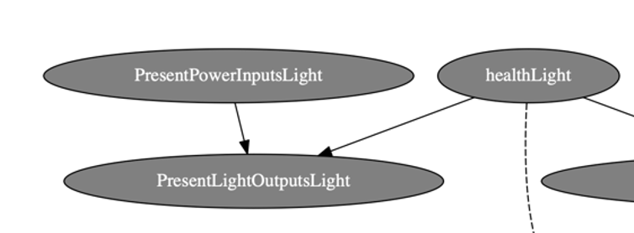
Voorbeelden python bestanden
Components.py
Oopnclasses.py
Influence diagram
light = {
"type":"Light",
"Inputs":{
"1":{
"modality":"Power",
"property":"Present",
"propertyvalues":["yes", "no"],
"priorprobability":[0.99,0.01]
}
},
"Outputs":{
"1":{
"modality":"Light",
"property":"Present",
"propertyvalues":["yes", "no"]
}
},
"Healths":{
"1":{
"modality":"Health",
"property":"health",
"propertyvalues":["ok","broken"],
"priorprobability":[0.99,0.01]
}
},
"Behavior":{
"normal": {
'PresentPowerInputs': ["yes", "no", "yes", "no"],
'PresentLightOutputs': ["yes", "no", "no", "no"],
'health': ["ok", "ok", "broken", "broken"]
}
}
}
class Component:
def __init__(self, name, specs):
# name component
self.name = name
# componentspecs type dict
self.specs = specs
# componentnodes, type Node
self.nodes = []
# arcs internal to component, list of tuples
self.internalconnections = []
# turns specs into nodes
self.createNodes()
# turn specs into internal arcs
self.setInternalConnections()
# prior outputnode, pyAgrum Potential
self.setPriorOutput()
# prior healthnode, pyAgrum Potential
self.setPriorHealth()
# prior inputs, pyAgrum Potential
self.setPriorInputs()
Inputs defined by modality with properties
Basic nodes
Output defined by modality with properties
Inputs, output and health nodes via class Node
Defining health of component
Generate internal connections
Prior output based on behavior table
Behavior table for cpt of output
Health and input priors supplied via specs

Slide 52
test type I

Slide 53
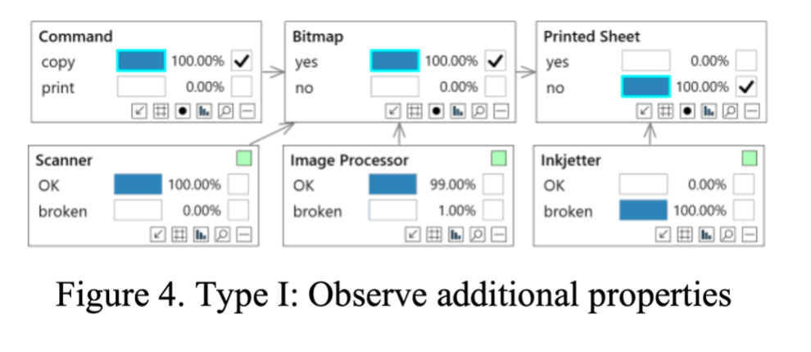
Test type I eisen
Bekijk status ‘andere’ onderdelen keten zodat er meer bewijs is om een mening over te vormen.
trigger, utility en besluit(en)
Output niet conform verwachting stuurt een besluit/utility combinatie aan. Het is logisch de check te kiezen die het goedkoopst is om te doen maar het zou ook “de middelste” kunnen zijn. Expert kennis van het systeem dient te bepalen welke component gecheckt wordt. Het testbesluit heeft betrekking op het wel/niet checken van 1 andere component.
Uitkomst en impact
De check levert meer evidence op over hoe het systeem functioneert. De impact is een meer realistisch beeld van de toestand van het systeem.
modellering
Output welke niet wordt verwacht dient de utility te triggeren die de test adviseert. Omdat de test geld kost zal deze nooit worden uitgevoerd tenzij er een boete is voor negeren van een situatie waarin moet worden ingegrepen. (net als bij de observe replace test)
De check levert extra evidence op maar dit hoeft niet via een aparte testoutcome node te worden gemodelleerd.
vervolg testen
Als de check is uitgevoerd en bekend gemaakt via evidence kan dit weer andere checks op andere onderdelen triggeren.
Variant van deze test kan zijn een test die meerdere checks in 1x triggert

Slide 54
Test type I, modellering
Concretisering genereren diagram en inference
Influence diagram voor component tbv verwerken observaties status systeem
Input
…
health
testbesluit
output
utility
Utility constateert output niet conform verwachting. Dit triggert via voorkeuren testbesluit.
Na uitvoer check is er extra evidence beschikbaar voor andere onderdelen van systeem.
Na uitvoer kan testbesluit / utility worden verwijdert?

Slide 55
Test type 1, implementatie
Beschrijving
Informatie model
Influence diagram
Diagnosticeren
Jupyter notebook
Specificaties; components.py, connections.py,
Tests.py
Assemblies.py
Network classes; oopnclasses.py,
Opbouwen informatiemodel:
oopnbuilder.py
Genereren influence diagram; diagrambuilder.py
Evidence
Inference
vergelijk sets utilities
Uitbreiden testmapping zodat type 1 test aan component(en) kan worden gekoppeld.
Toevoegen benodigde parameters voor networkklasse
Netwerk klasse toevoegen type 1 test:
OutputTarget: Node
TestDecision: Node
TestUtility: Node
Interne + externe verbindingen
Kunnen genereren extra testtype vanuit informatiemodel.
Bij ontvangen evidence deze toevoegen aan systeemnodes.

Slide 56
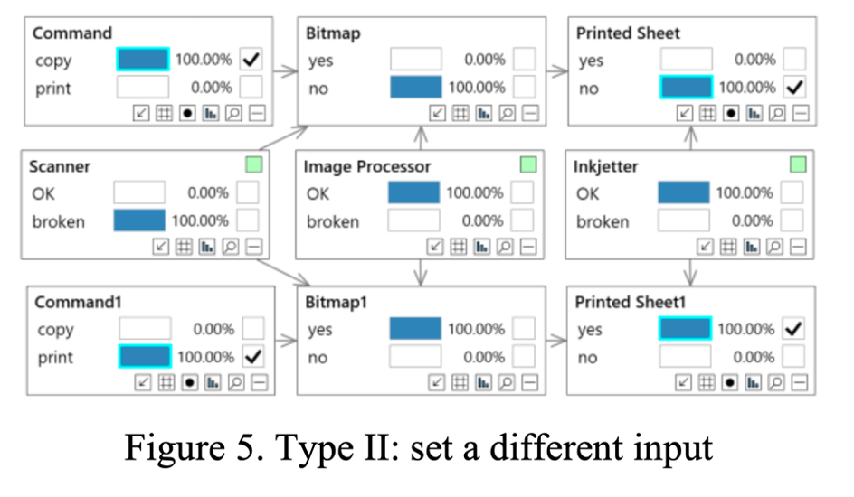
test type II
Bron: Differential Diagnosis with Active Testing, Emile van Gerwen, Leonardo Barbini, and Michael Borth
Type II: set a different input
A second type of diagnostic test consists of setting a different input to the system. This is a fundamentally different type of test than the previous one. Firstly, we are not only observing, but we are intervening in the system, by doing the action of changing an input. Secondly, the result of the action could potentially lead to a different observation than in the absence of said action, making it counterfactual.
Our approach is to augment the BN when doing a test comprising an intervention. This augmentation procedure has two steps. Firstly, we duplicate all the nodes in the BN except for the health nodes and the input nodes which are not set to a different value (with input nodes referring to BN nodes that have no parents and are not of type health). Secondly, we connect the duplicated nodes as children of the original health nodes. This approach – and not, as is sometimes assumed, just updating the priors using the result of the inference – delivers the correct inference model, as Balke & Pearl showed (1994). Notice that with this augmentation procedure there is no need to specify new conditional probability tables, as they are the same as in the original, not augmented BN.
Figure 5 shows an example of this augmentation procedure. The starting point is the diagnosis BN in Figure 3. The duplicated nodes have a 1 at the end of their names, e.g., Command1. We now observe a Printed Sheet1 for the printer input Command1 print. As the augmented BN’s reasoning also includes the evidence coming from the situation when copying failed, it infers that the only possible diagnostic solution is that the Scanner is broken and the Image Processor and InkJetter are OK.

Slide 57
Test type II, eisen modellering
Voeden systeem met andere input voor beter inschatten health componenten
trigger en testbesluit
Output niet conform verwachting stuurt een testbesluit aan. Het testbesluit heeft betrekking op het voeden van andere invoer aan het systeem en vervolgens checken output. Zo ontstaat extra evidence om health van componenten te bepalen.
testuitkomst
Als de test is uitgevoerd is extra evidence beschikbaar voor (een deel) van het systeem. Een diagram uitbreiding is nodig om de extra informatie te kunnen gebruiken tijdens inference.
aanpak
In het initiële influence diagram is het testbesluit opgenomen maar niet de uitbreiding om extra evidence te verwerken. Zodra test is uitgevoerd wordt systeem uitgebreid maar is testbesluit niet meer relevant. Een dynamische aanpak dus.
implementatie
output welke niet wordt verwacht triggert de testutility welke de test adviseert
de test wordt uitgevoerd en levert extra evidence voor (een deel) van het systeem
het systeem wordt uitgebreid met kopieën van componenten waarvoor extra evidence beschikbaar is
met de extra evidence kan door inference een betere inschatting van de health van componenten worden gedaan

Slide 58
Test type II, eisen modellering
influence diagram voor uitvoeren test en erna
Influence diagram met type 2 testbesluit maar zonder uitbreiding systeem
Influence diagram na uitvoeren test van type II
input
Input
x
input
y
…
health
…
health
…
… = meerdere componenten
testbesluit
output
output
z
output
?
testutility
Utility constateert output niet conform verwachting en triggert dan testbesluit. Utility kan dit regelen met a. kosten test en b. ‘boetes’.
Additioneel kan de input van de keten welke getest moet worden verbonden worden met de testutility. Hiermee kan de geselecteerde input een rol spelen bij het triggeren.
Evidence toont aan dat test is uitgevoerd, bijvoorbeeld via 2x evidence voor de keten.
De extra evidence wordt niet ingevoerd in het influence diagram dat links staat maar verwerking gaat terug naar informatiemodel om het systeem uit te breiden.
Omdat test is uitgevoerd zitten utility + testbesluit niet meer in diagram.
nb. tenzij test nog een keer moet worden uitgevoerd voor andere input combinatie?
Het deel van de keten tussen de input en output wordt gedupliceerd. Dit kan meerdere componenten betreffen, de verschillende extra output nodes worden verbonden met de health van het originele component.

Slide 59
Test type II, implementatie ‘ChangeInputTest’
Beschrijving
Informatie model
Influence diagram
Diagnosticeren
Jupyter notebook
Specificaties; components.py, connections.py,
tests.py
assemblies.py
Network classes; oopnclasses.py,
Opbouwen informatiemodel:
oopnbuilder.py
Genereren influence diagram; diagrambuilder.py
Evidence
Inference
vergelijk sets utilities
Uitbreiden testmapping zodat ChangeInputTest aan component(en) kan worden gekoppeld.
De testspecificatie bevat:
Utility: kosten/boetes
Testbesluit: yes/no
Componenten start en eind keten
Netwerk klasse toevoegen ChangeInputTest:
OutputTarget: Node, = link andere component
TestDecision: Node
TestUtility: Node
Interne verbindingen
Uitbreiding informatiemodel klasse voor na uitvoeren test:
Bepalen te kopieren pad start / eind
Kopieer componenten en connecties, verbind met:
- originele nodes niet in pad
- healths
Toevoegen extra testtype
Bij ontvangen evidence bepalen of diagram opnieuw moet worden gegenereerd via aangepast informatiemodel.

Slide 60
Test type II, learnings implementatie
Influence diagram oplossing uitgebreid met test type2
gebruikt voorbeeld
Voorbeeld systeem gebruikt met switches, lampjes en wires.
Systeem: Switch > Wire > Light > Wire2 > Switch1 > Wire3 > Light1 > Wire4 > Switch2 > Wire5 > Light2
Verbinden light met switch wellicht niet intuitief maar dat maakt voor modellering niet uit.
Keten waarvoor input wordt gevarieerd loopt van Light1 tot en met Light2.
test utility en decision
Testutility verbonden aan output node om testbesluit te triggeren. Kosten en boetes sturen utility naar volgende gedrag, zie hiernaast.
Op volgorde hoogste utility:
indien output gewenst / doe niets
Indien output niet gewenst / doe test
Indien output niet gewenst / doe niets
Indien output gewenst / doe test
transitie
Indien 2 sets aan evidence worden geconstateerd is dat signaal dat de test is uitgevoerd en wordt eerst informatiemodel aangepast om nieuw influence diagram te genereren.
testuitkomst dmv kopieren keten
-Start keten is een inputnode, eind een outputnode van een andere component.
-Tussenliggende nodes moeten worden afgeleid, dat is gedaan via “shortest path” methode.
-Er worden kopie componenten gemaakt: nodes in de te kopiëren keten worden nieuw toegevoegd maar overige nodes worden hergebruikt van originele component (bijvoorbeeld andere inputs, health).
-Output gekopieerde component wordt verbonden met health (en eventueel input) originele component.
-Met aangepast informatiemodel wordt nieuw influence diagram gegenereerd waarmee inference kan worden uitgevoerd gegeven de extra evidencee.

Slide 61
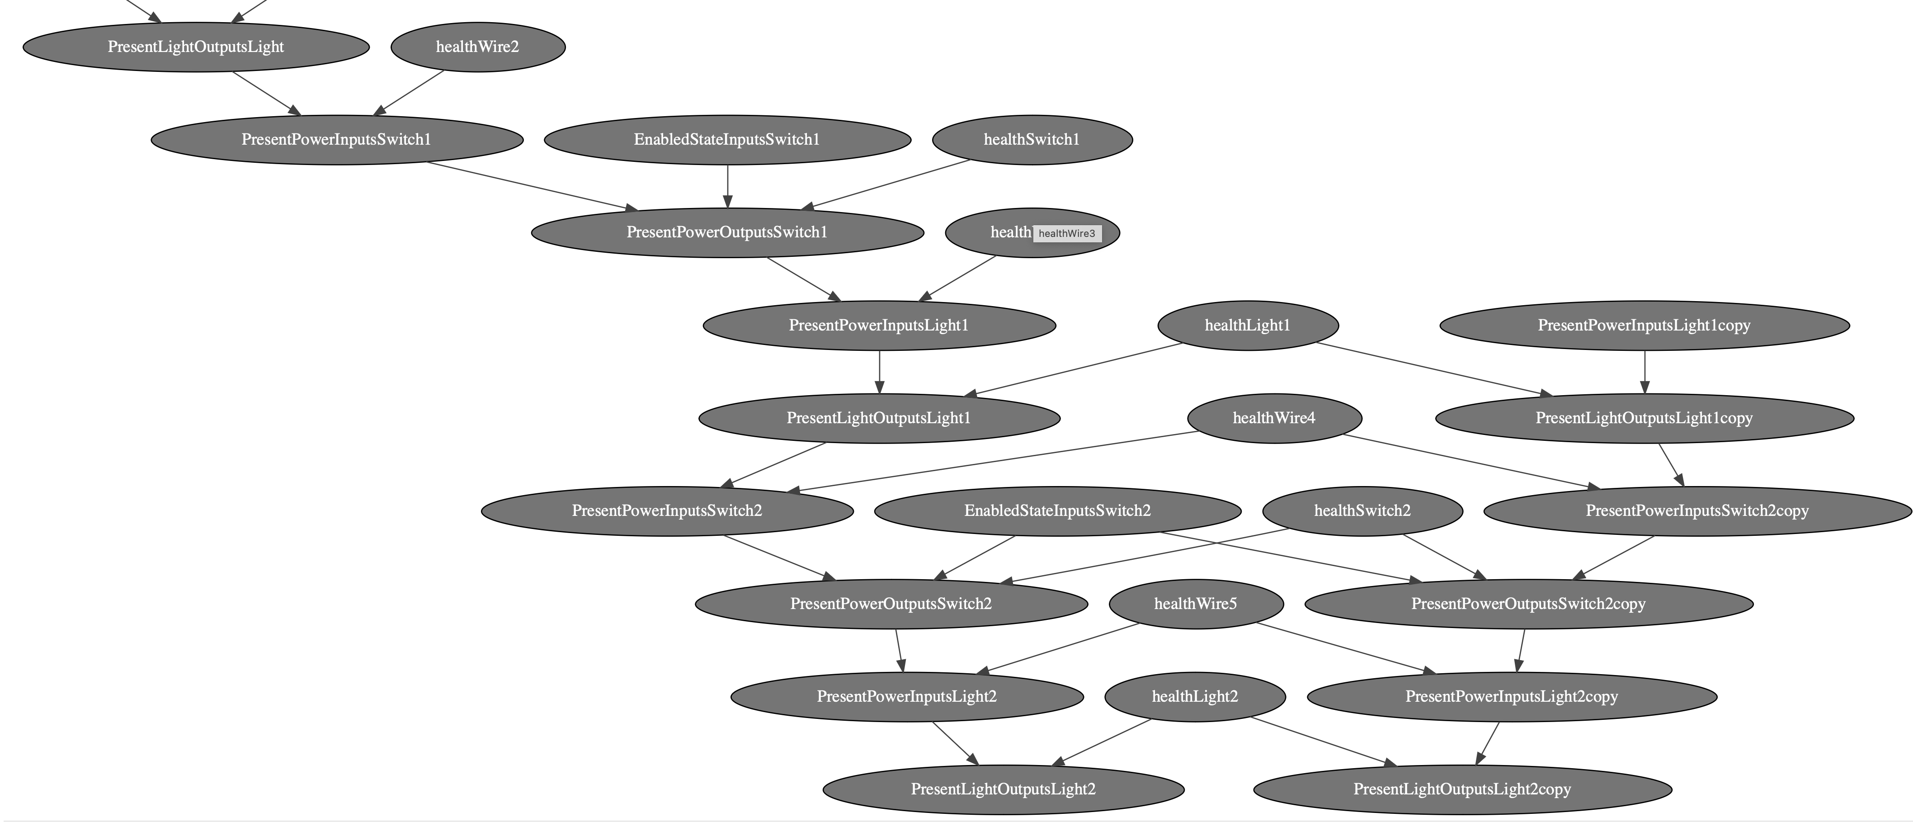
Test type II, learnings implementatie
Diagram voorbeeld na uitbreiding…
Eerste deel naam is eigenschap en type: PresentPowerInputs..
Laatste deel naam is component: …Light / …Wire2 etc
deel systeem zonder kopie
Gekopieerde componenten
Keten is van light1 tot en met light2 en start bij PresentPowerInputsLight1.
Nodes met “copy” in naam zijn onderdeel gekopieerde keten.
healthLight1 verbonden met 2 outputs, origineel en ”copy”
hergebruik EnabledStateInputsSwitch2 binnen gekopieerde component

Slide 62
Test type II, learnings implementatie
evaluatie
aanpak en modelleren
Het aanpassen van het informatiemodel en dan opnieuw genereren influence diagram werkt.
Tijdens implementie keuze moeten maken hoe kopieren in zijn werk gaat. Uiteindelijk gekozen om kopie componenten te maken en hierbij nodes van originele component te hergebruiken.
implementatie
pyAgrum heeft geen optie om route uit te rekenen, met python library networkx is snel een DAG te maken en het pad uit te rekenen.
De oorspronkelijke aanpak van het informatiemodel werkt door specs te lezen en daar componenten of connecties van te maken. Op dit punt zijn kopie componenten te definieren kan de rest van het genereren worden hergebruikt (zoals vaststellen probability tabellen).
validatie
Nog niet gedaan

Slide 63
BV: aziaat, roker
PV: bronchites, kanker, TB
MV:TB_or_cancer
SV: xray / dyspnoea

Slide 64
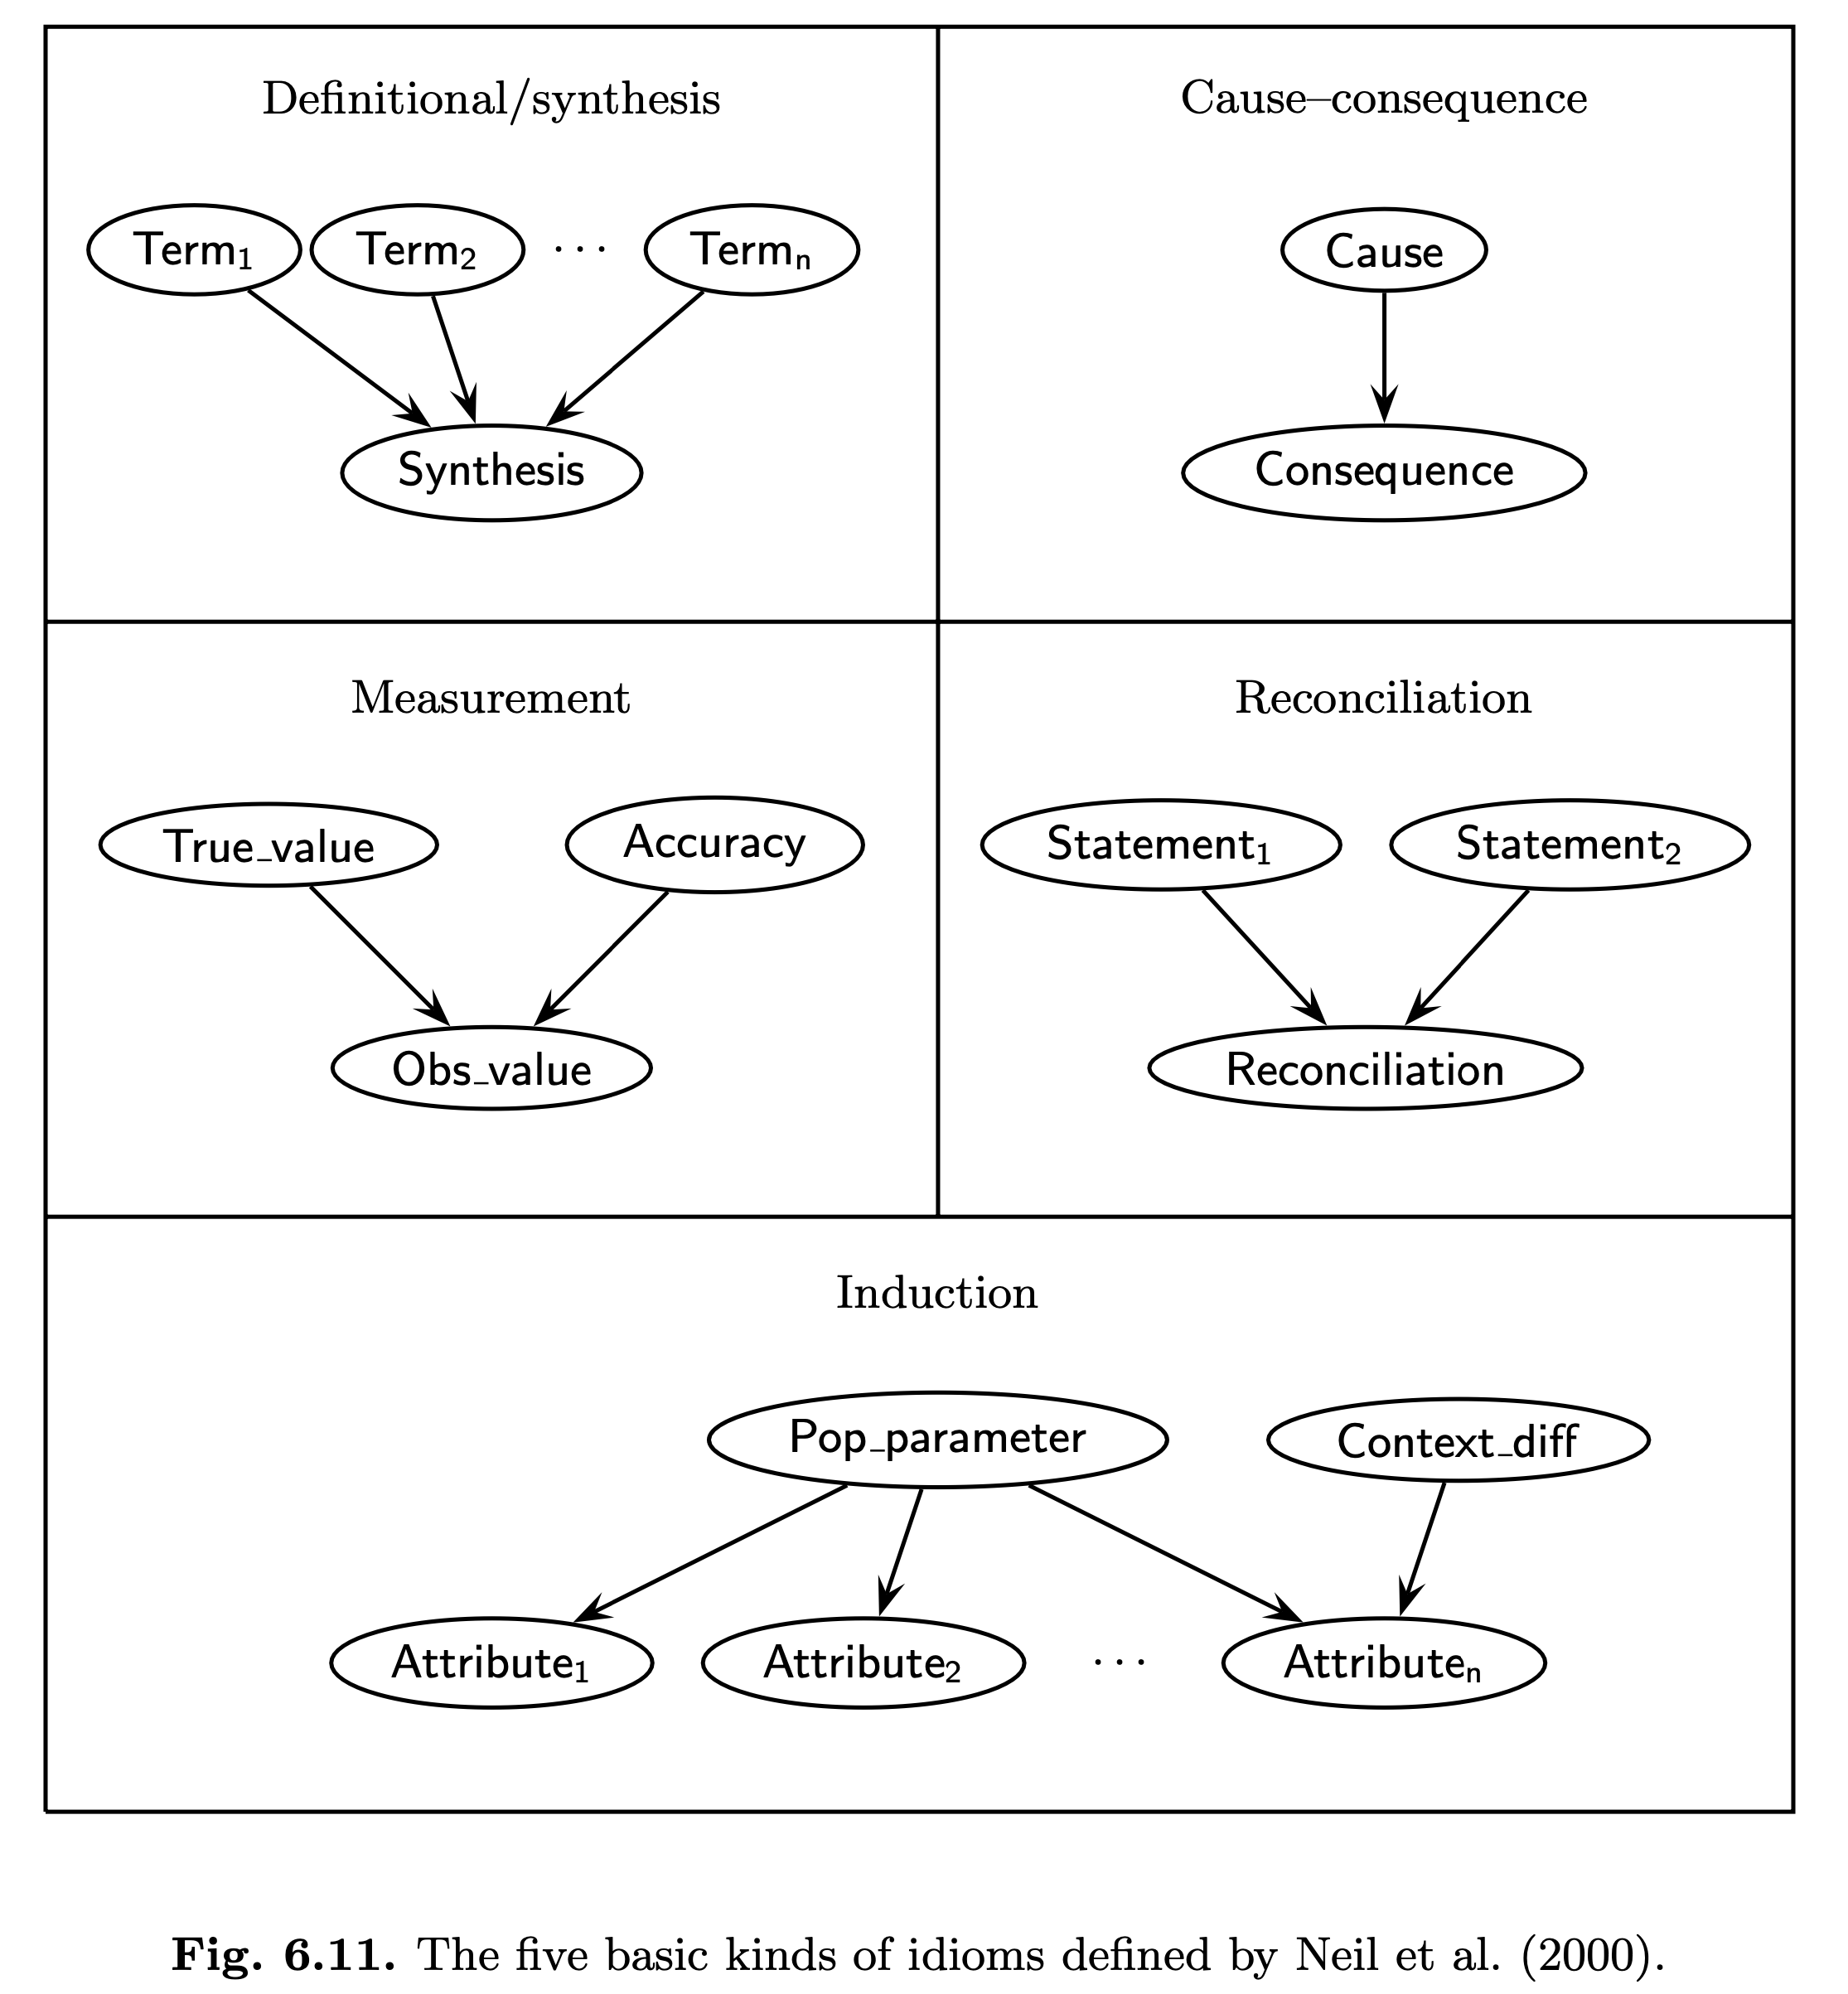
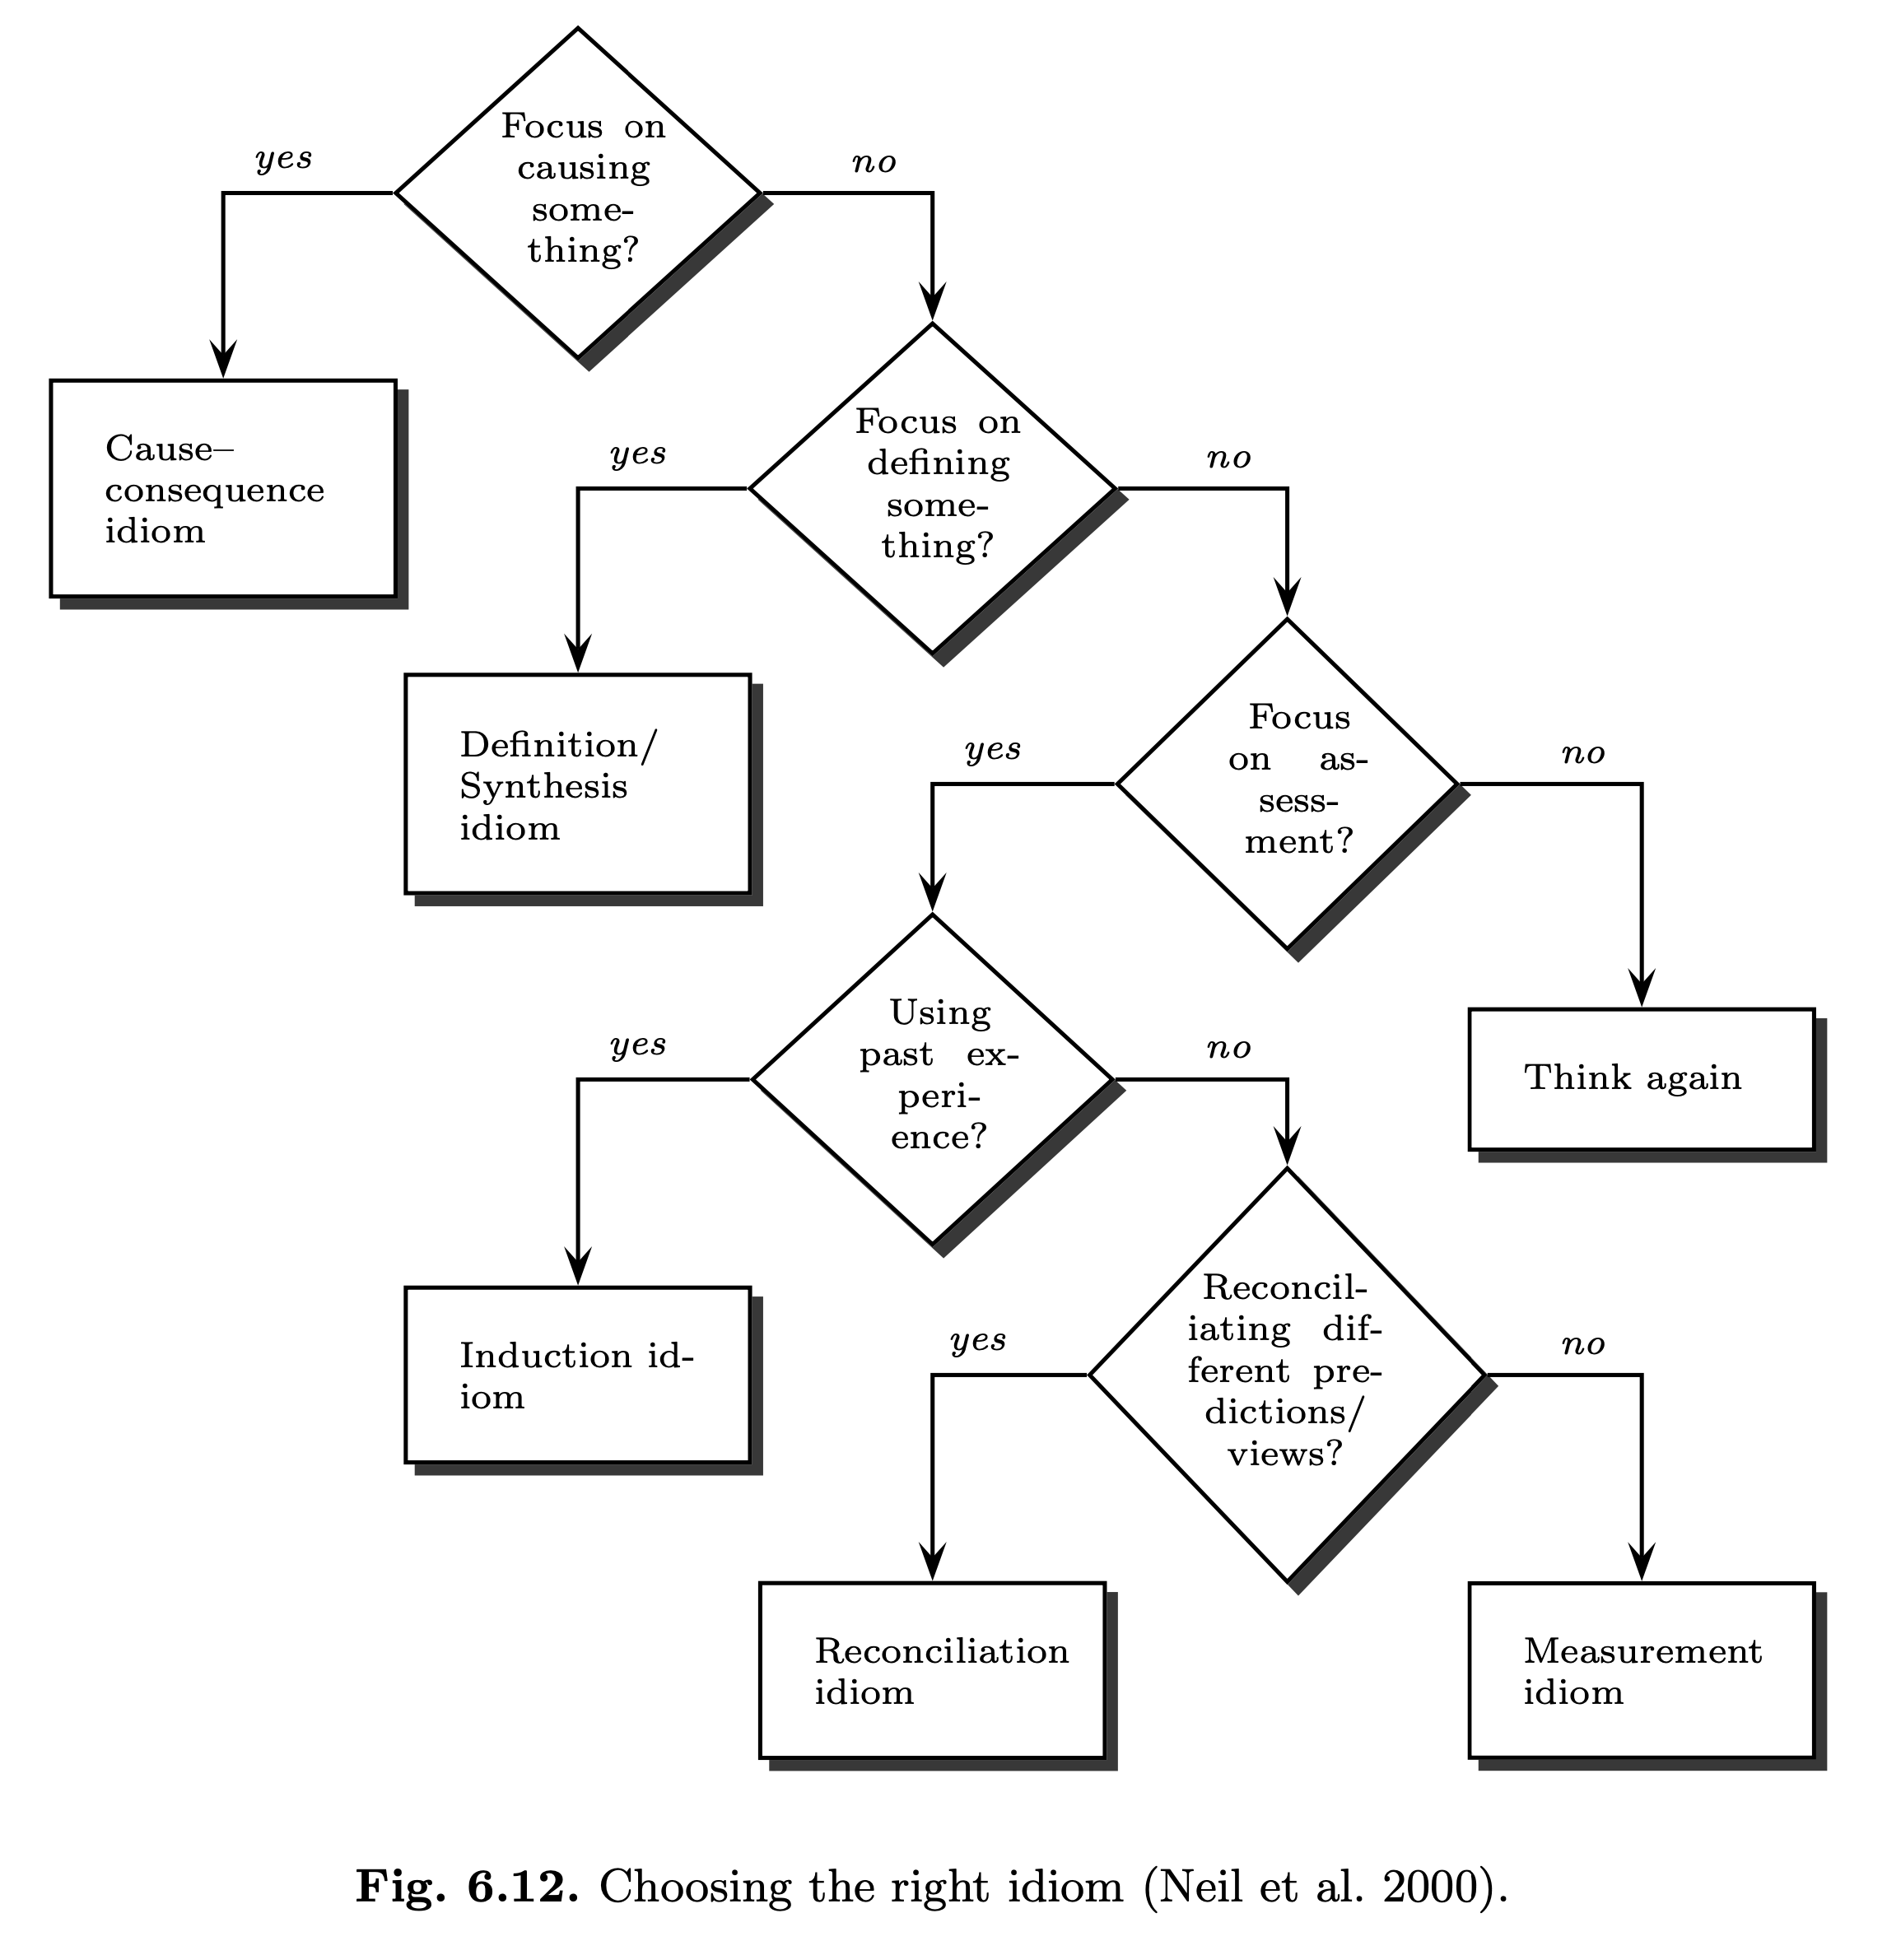
idioms
Definitional/synthesis: Models the combination of variables into a sin- gle variable, including deterministic or uncertain definition/function of a variable in terms of other variables.
Cause–consequence: Models cause–effect mechanisms (causal processes).
Measurement: Models the uncertainty associated with an observation or measurement.
Induction: Models inductive reasoning based on observations from similar entities to infer something about an unobserved entity.
Reconciliation: Models the reconciliation of results from competing statements that arise from different sources of information.

Slide 65
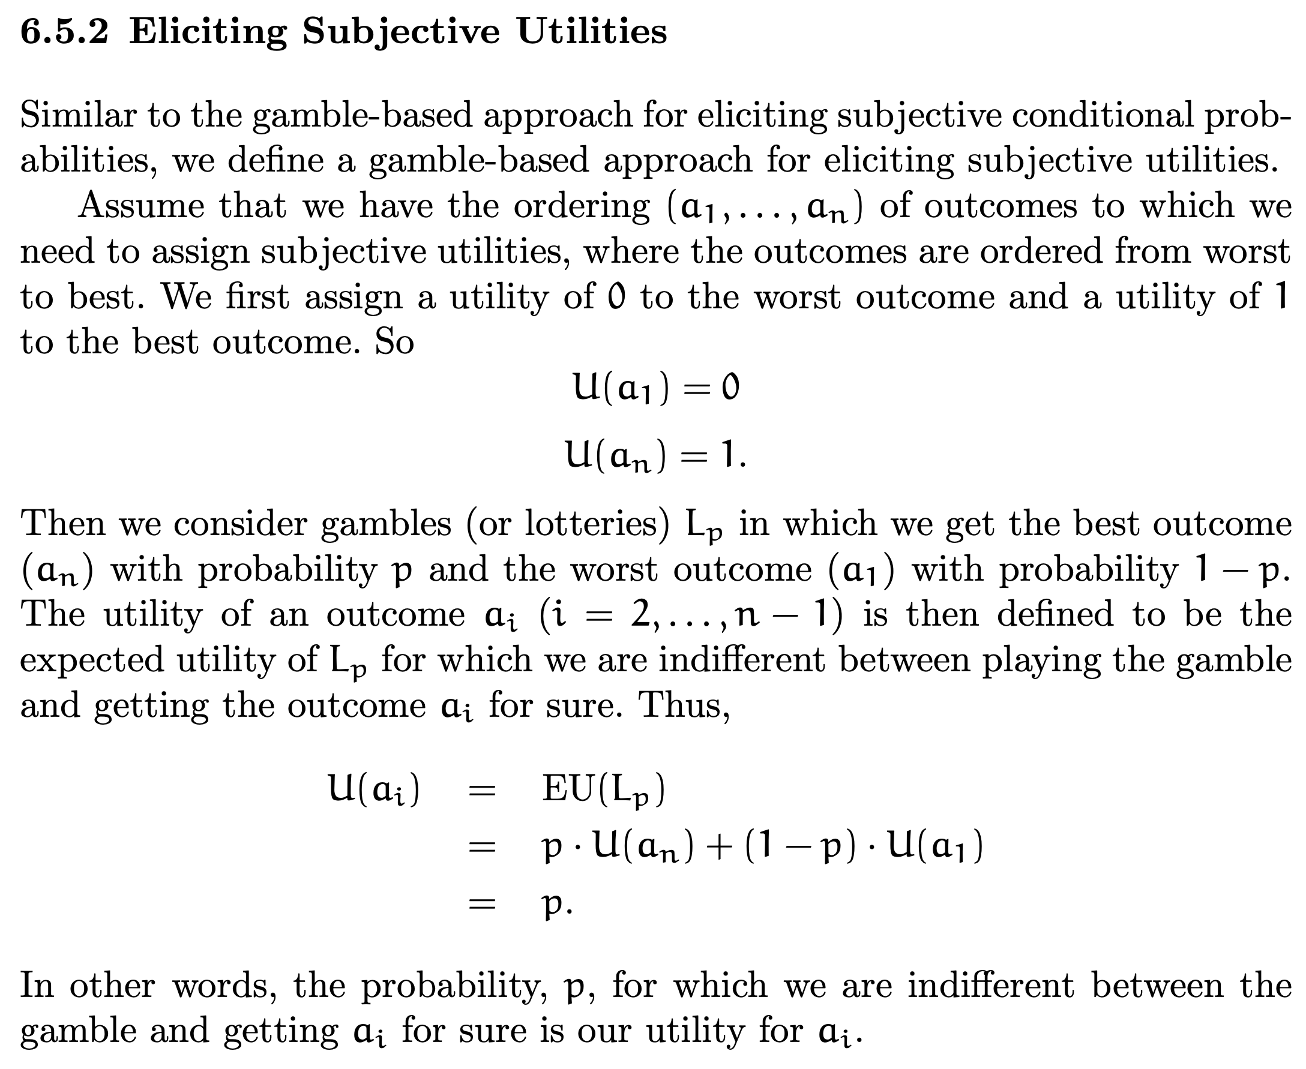

Slide 66
How to Implement This Technique
The test decisions modeling technique is implemented as follows.
(1) Let P be a discrete random variable representing the phenomenon that may be measured by a test.
(2) Create a decision variable T with two states no test and test corresponding to not performing and performing the test, respectively.
(3) Create a discrete random variable R representing the result of the test as a child of D and P.
(4) Let R have one state for each possible test result and the state no result representing the event that the test is not performed, i.e., T = no test.
(5) Define the conditional probability distribution P(R|P,T) such that P(R = no result|P,T = no test) = 1 and P(R|P,T = test) encodes the probability of each possible test result given the actual value of phenomenon P.

Slide 67
Agenda
1 Introduction
2 Influence diagram
4 Test modeling
5 Root cause analysis
6 Conclusion
Business context
Research question
3 Auto generation

Slide 68
Contributions to the key challenges
Contribution
 | Generation | First steps | Type II tests | Pragmatic approach
Automatic generation | xxx | x | x | x
Modeling tests |  |  | xxx | xxx
Root cause analysis |  | xxx |  | xxx
Key challenge

Slide 69
First steps
Total order on decisions
Limited Memory Influence Diagram (LIMID)
A fixed pattern per component, observation and replace.
Myopic search algorithm

